Slide 1
Conceptual model of UML

Slide 2
Introduction
To learn a new language, for example, let’s consider English, we learn the character set (a-z) first and then the words and then several rules to form sentences using those words.
Similarly to understand UML, we should learn the vocabulary and then rules for creating UML diagrams.
The conceptual model of UML contains the UML’s vocabulary and rules.
So, to understand using UML and to create using UML diagrams first we need to learn the conceptual model of UML.

Slide 3
Introduction
The conceptual model of UML contains the fundamentals of UML.
The conceptual model consists of three parts. They are:
1) Building blocks of UML (syntax / vocabulary)
2) Rules (dictate how those building blocks may be put together)
3) Common Mechanisms

Slide 4
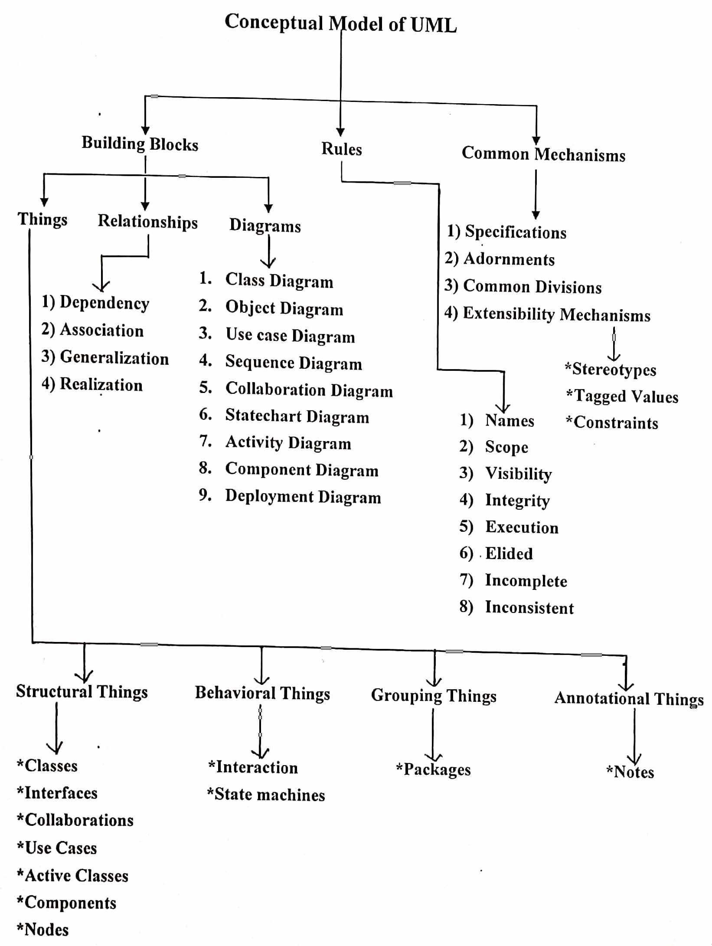

Slide 5
Building blocks of UML
The vocabulary of the UML encompasses three kinds of building blocks:
1) Things
2) Relationships
3) Diagrams
Things are the abstractions that are first-class citizens in a model.
Relationships tie these things together.
Diagrams group interesting collections of things.

Slide 6
Things
Things are the basic object-oriented building blocks of the UML. You use them to write well formed models.
There are four kinds of things in the UML.
1) Structural things (nouns of UML – static parts)
2) Behavioral things (verbs of UML – dynamic parts)
3) Grouping things (organizational parts)
4) Annotational things (explanatory parts)

Slide 7
Structural things
Structural things are the nouns of UML models.
These are the mostly static parts of a model, representing elements that are either conceptual or physical.
There are seven kinds of structural things.

Slide 8
1. Class
Class is a description of a set of objects that share the same attributes, operations, relationships, and semantics.
A class implements one or more interfaces.
Graphically, a class is rendered as a rectangle, usually including its name, attributes, and operations.

Slide 9
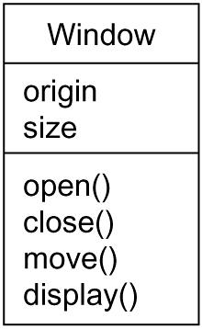
1. Class

Slide 10
2. Interface
Interface is a collection of operations that specify a service of a class or component.
An interface describes the externally visible behavior of that element.
An interface might represent the complete behavior of a class or component or only a part of that behavior.
Graphically, an interface is rendered as a circle together with its name.

Slide 11

2. Interface

Slide 12
3. Collaboration
Collaboration defines an interaction and is a society of roles and other elements that work together to provide some cooperative behavior that's bigger than the sum of all the elements.
Graphically, a collaboration is rendered as an ellipse with dashed lines, usually including only its name.

Slide 13
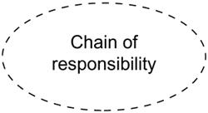
3. Collaboration

Slide 14
4. Use case
use case is a description of set of sequence of actions that a system performs that yields an observable result of value to a particular actor.
A use case is used to structure the behavioral things in a model.
Graphically, a use case is rendered as an ellipse with solid lines, usually including only its name.

Slide 15
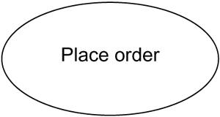
4. Use case

Slide 16
5. Active class
An active class is a class whose objects own one or more processes or threads and initiate control activity.
Graphically, an active class is rendered just like a class, but with heavy lines, usually including its name, attributes, and operations.

Slide 17
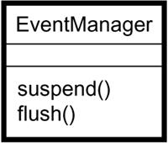
5. Active class

Slide 18
6. Component
A component is a physical and replaceable part of a system that conforms to and provides the realization of a set of interfaces.
Different kinds of deployment components, such as COM+ components or Java Beans.
Graphically, a component is rendered as a rectangle with tabs, usually including only its name.

Slide 19
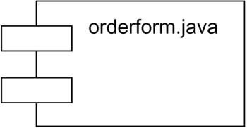
6. Component

Slide 20
7. Node
A node is a physical element that exists at run time and represents a computational resource, generally having at least some memory and, often, processing capability.
Graphically, a node is rendered as a cube, usually including only its name.

Slide 21
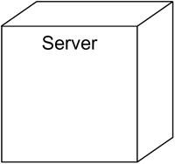
7. Node

Slide 22
Behavioral Things
Behavioral things are the dynamic parts of UML models.
These are the verbs of a model, representing behavior over time and space.
In all, there are two primary kinds of behavioral things.

Slide 23
1. Interaction
An interaction is a behavior that comprises a set of messages exchanged among a set of objects within a particular context to accomplish a specific purpose.
An interaction involves a number of other elements, including messages, action sequences (the behavior invoked by a message), and links (the connection between objects).
Graphically, a message is rendered as a directed line, almost always including the name of its operation.

Slide 24

1. Interaction

Slide 25
2. State Machine
A state machine is a behavior that specifies the sequences of states an object or an interaction goes through during its lifetime in response to events, together with its responses to those events.
A state machine involves a number of other elements, including states, transitions (the flow from state to state), events (things that trigger a transition), and activities (the response to a transition).
Graphically, a state is rendered as a rounded rectangle, usually including its name and its substates.

Slide 26
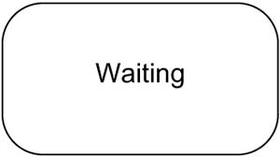
2. State Machine

Slide 27
Grouping Things
Grouping things are the organizational parts of UML models.
These are the boxes into which a model can be decomposed.
There is one primary kind of grouping thing, namely, packages.

Slide 28
1. Package
A package is a general-purpose mechanism for organizing elements into groups.
Structural things, behavioral things, and even other grouping things may be placed in a package.

Slide 29
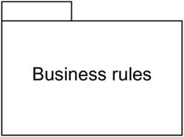
1. package

Slide 30
Annotational Things
Annotational things are the explanatory parts of UML models.
These are the comments you may apply to describe, illuminate, and remark about any element in a model.
There is one primary kind of annotational thing, called a note.
A note is simply a symbol for rendering constraints and comments attached to an element or a collection of elements.
Graphically, a note is rendered as a rectangle with a dog-eared corner, together with a textual or graphical comment.

Slide 31
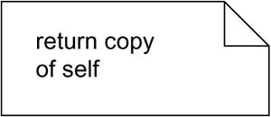
Annotational Things

Slide 32
Relationships in the UML
The things in a diagram are connected through relationships. So, a relationship is a connection between two or more things.
There are four kinds of relationships in the UML:
1. Dependency
2. Association
3. Generalization
4. Realization

Slide 33
1. Dependency
Dependency is a semantic relationship between two things in which a change to one thing (the independent thing) may affect the semantics of the other thing (the dependent thing).
Graphically, a dependency is rendered as a dashed line, possibly directed, and occasionally including a label

Slide 34

1. Dependency

Slide 35
2. Association
An association is a structural relationship that describes a set of links, a link being a connection among objects.
Aggregation is a special kind of association, representing a structural relationship between a whole and its parts.
Graphically, an association is rendered as a solid line, possibly directed, occasionally including a label, and often containing other adornments, such as multiplicity and role names,

Slide 36

2. Association

Slide 37
3. Generalization
Generalization is a specialization/generalization relationship in which objects of the specialized element (the child) are substitutable for objects of the generalized element (the parent).
The child shares the structure and the behavior of the parent.
Graphically, a generalization relationship is rendered as a solid line with a hollow arrowhead pointing to the parent

Slide 38

3. Generalization

Slide 39
4. Realization
A Realization is a semantic relationship between classifiers, wherein one classifier specifies a contract that another classifier guarantees to carry out.
You will find realization relationships in two places:
1) between interfaces and the classes or components that realize them, and
2) between use cases and the collaborations that realize them.
Graphically, a realization relationship is rendered as a cross between a generalization and a dependency relationship.

Slide 40

4. Realization

Slide 41
Diagrams in the UML
A diagram is the graphical presentation of a set of elements, most often rendered as a connected graph of vertices (things) and arcs (relationships).
You draw diagrams to visualize a system from different perspectives, so a diagram is a projection into a system.
UML includes nine diagrams:

Slide 42
Diagrams in the UML
1. Class diagram
2. Object diagram
3. Use case diagram
4. Sequence diagram
5. Collaboration diagram
6. Statechart diagram
7. Activity diagram
8. Component diagram
9. Deployment diagram

Slide 43
1. Class diagram
A class diagram shows a set of classes, interfaces, and collaborations and their relationships.
These diagrams are the most common diagram found in modeling object-oriented systems.
Class diagrams address the static design view of a system.
Class diagrams include active classes address the static process view of a system.

Slide 44
2. Object diagram
An object diagram shows a set of objects and their relationships.
Object diagrams represent static snapshots of instances of the things found in class diagrams.
These diagrams address the static design view or static process view of a system as do class diagrams.

Slide 45
3. Use case diagram
A use case diagram shows a set of use cases and actors (a special kind of class) and their relationships.
Use case diagrams address the static use case view of a system.
These diagrams are especially important in organizing and modeling the behaviors of a system.

Slide 46
4. Sequence diagram
Both sequence diagrams and collaboration diagrams are kinds of interaction diagrams.
Interaction consists of a set of objects and their relationships, including the messages that may be dispatched among them.
Interaction diagrams address the dynamic view of a system.
A sequence diagram is an interaction diagram that emphasizes the time-ordering of messages.

Slide 47
5. Collaboration diagram
Collaboration diagram is an interaction diagram that emphasizes the structural organization of the objects that send and receive messages.
Sequence diagrams and collaboration diagrams are isomorphic, meaning that you can take one and transform it into the other.

Slide 48
6. Statechart diagram
A statechart diagram shows a state machine, consisting of states, transitions, events, and activities.
Statechart diagrams address the dynamic view of a system.
They are especially important in modeling the behavior of an interface, class, or collaboration and emphasize the event-ordered behavior of an object, which is especially useful in modeling reactive systems.

Slide 49
7. Activity diagram
An activity diagram is a special kind of a statechart diagram that shows the flow from activity to activity within a system.
Activity diagrams address the dynamic view of a system.
They are especially important in modeling the function of a system and emphasize the flow of control among objects.

Slide 50
8. Component diagram
A component diagram shows the organizations and dependencies among a set of components.
Component diagrams address the static implementation view of a system.
They are related to class diagrams in that a component typically maps to one or more classes, interfaces, or collaborations.

Slide 51
9. Deployment diagram
A deployment diagram shows the configuration of run-time processing nodes and the components that live on them.
Deployment diagrams address the static deployment view of an architecture.
They are related to component diagrams in that a node typically encloses one or more components.

Slide 52
Rules of the UML
The rules of UML specify how the UMLs building blocks come together to develop diagrams.
The rules enable the users to create well-formed models.
A well-formed model is self-consistent and also consistent with the other models.

Slide 53
Rules of the UML
Names - What you can call things, relationships, and diagrams
Scope - The context that gives specific meaning to a name
Visibility - How those names can be seen and used by others
Integrity - How things properly and consistently relate to one another
Execution - What it means to run or simulate a dynamic model
Elided - Certain elements are hidden to simplify the view
Incomplete - Certain elements may be missing
Inconsistent - The integrity of the model is not guaranteed

Slide 54
Common Mechanisms in the UML
Why UML is easy to learn and use? It’s because of the four common mechanisms that apply throughout the UML. They are:
Specifications
Adornments
Common divisions
Extensibility mechanisms

Slide 55
1. Specifications
The UML's specifications provide a semantic backplane that contains all the parts of all the models of a system, each part related to one another in a consistent fashion.
It provides a textual statement of the syntax and semantics of that building block.
For example, behind a class icon is a specification that provides the full set of attributes, operations (including their full signatures), and behaviors that the class embodies

Slide 56
2. Adornments
UML have a unique and direct graphical notation that provides a visual representation of the most important aspects of the element.
For example, the below Figure shows a class, adorned to indicate that it is an abstract class with two public(+), one protected(#), and one private operation(-).

Slide 57
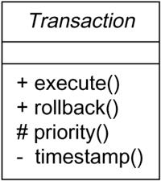
2. Adornments

Slide 58
3. Common divisions
In UML there is clear division between semantically related elements like:
Separation between a class and an object.
Separation between an interface and its implementation.

Slide 59
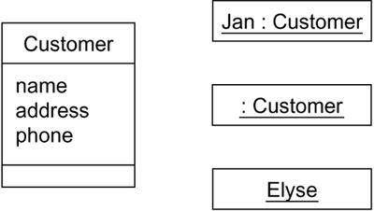
3. Common divisions

Slide 60
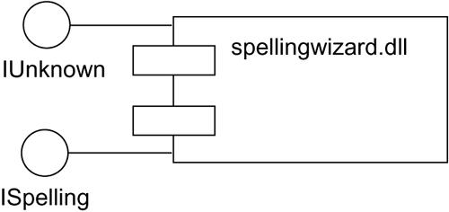
3. Common divisions

Slide 61
4. Extensibility mechanisms
UMLs extensibility mechanisms allow the user to extend (new additions) the language in a controlled way.
The extensibility mechanisms in UML are:
Stereotypes
Tagged values
Constraints

Slide 62
1. Stereotypes
A stereotype extends the vocabulary of the UML, allowing you to create new kinds of building blocks that are derived from existing ones but that are specific to your problem.
For example, if you are working in a programming language, such as Java or C++, you will often want to model exceptions. In these languages, exceptions are just classes, although they are treated in very special ways.

Slide 63
2. Tagged values
A tagged value extends the properties of a UML building block, allowing you to create new information in that element's specification.
They can be added to any building block, such as a class, by introducing new tagged values to that building block.

Slide 64
3. Constraints
A constraint extends the semantics of a UML building block, allowing you to add new rules or modify existing ones.

Slide 65
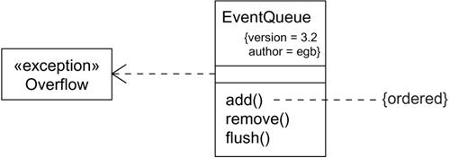
Extensibility mechanisms

