Slide 1
Architecture

Slide 2
Architecture
A model is a simplified representation of the system.
To visualize a system, we will build various models.
The subset of these models is a view.
Architecture is the collection of several views.
The stakeholders (end users, analysts, developers, system integrators, testers, technical writers and project managers) of a project will be interested in different views.

Slide 3
Architecture
Architecture is the set of significant decisions about
The organization of a software system
The selection of the structural elements and their interfaces by which the system is composed
Their behavior, as specified in the collaborations among those elements
The composition of these structural and behavioral elements into progressively larger Subsystems
The architectural style that guides this organization: the static and dynamic elements and their interfaces, their collaborations, and their composition.

Slide 4
Architecture
Software architecture is not only concerned with structure and behavior, but also with usage, functionality, performance, resilience, reuse, comprehensibility, economic and technology constraints and trade-offs, and aesthetic concerns.

Slide 5
Architecture
The architecture of a software-intensive system can best be described by five interlocking views.
Use case view
Design/logical view
Implementation/development view
Process view
Deployment/physical view
Each view is a projection into the organization and structure of the system, focused on a particular aspect of that system.

Slide 6
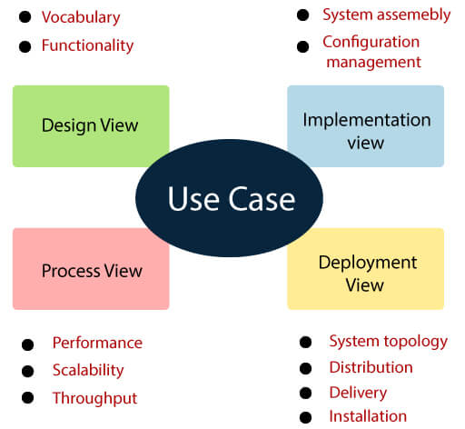
Architecture
Behavior

Slide 7
1. Use case view
The use case view of a system encompasses the use cases that describe the behavior of the system as seen by its end users, analysts, and testers.
This view doesn't really specify the organization of a software system that specify the forces that shape the system's architecture.
The static aspects of this view are captured in use case diagrams.
The dynamic aspects of this view are captured in interaction diagrams, statechart diagrams, and activity diagrams.

Slide 8
2. Design view
The design view of a system encompasses the classes, interfaces, and collaborations that form the vocabulary of the problem and its solution.
This view primarily supports the functional requirements of the system, meaning the services that the system should provide to its end users.
The static aspects of this view are captured in class diagrams and object diagrams.
The dynamic aspects of this view are captured in interaction diagrams, statechart diagrams, and activity diagrams.

Slide 9
3. Implementation view
The implementation view of a system encompasses the components and files that are used to assemble and release the physical system.
This view primarily addresses the configuration management of the system's releases, made up of independent components and files that can be assembled in various ways to produce a running system.
The static aspects of this view are captured in component diagrams.
The dynamic aspects of this view are captured in interaction diagrams, statechart diagrams, and activity diagrams.

Slide 10
4. Process view
The process view of a system encompasses the threads and processes that form the system's concurrency and synchronization mechanisms.
This view primarily addresses the performance, scalability, and throughput of the system.
The static and dynamic aspects of this view are captured in the same kinds of diagrams as for the design view.

Slide 11
5. Deployment view
The deployment view of a system encompasses the nodes that form the system's hardware topology on which the system executes.
This view primarily addresses the distribution, delivery, and installation of the parts that make up the physical system.
The static aspects of this view are captured in deployment diagrams.
The dynamic aspects of this view are captured in interaction diagrams, statechart diagrams, and activity diagrams.

Slide 12
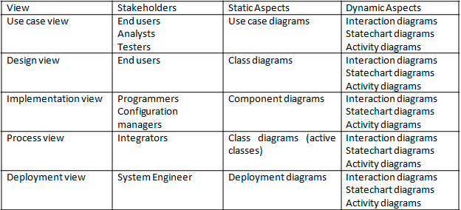
Architecture

Slide 13
Architecture
These five different stakeholders can focus on the issues of the system's architecture.
These five views also interact with one another nodes in the deployment view hold components in the implementation view that, in turn, represent the physical realization of classes, interfaces, collaborations, and active classes from the design and process views.

