Slide 1
Overview of UML
The Unified Modeling Language (UML) is a standard language for writing software blueprints.
The UML may be used to visualize, specify, construct, and document the artifacts of a software intensive system.

Slide 2
Overview of UML
The UML is a language for Visualizing, Specifying, Constructing, Documenting the artifacts of a software intensive system.

Slide 3
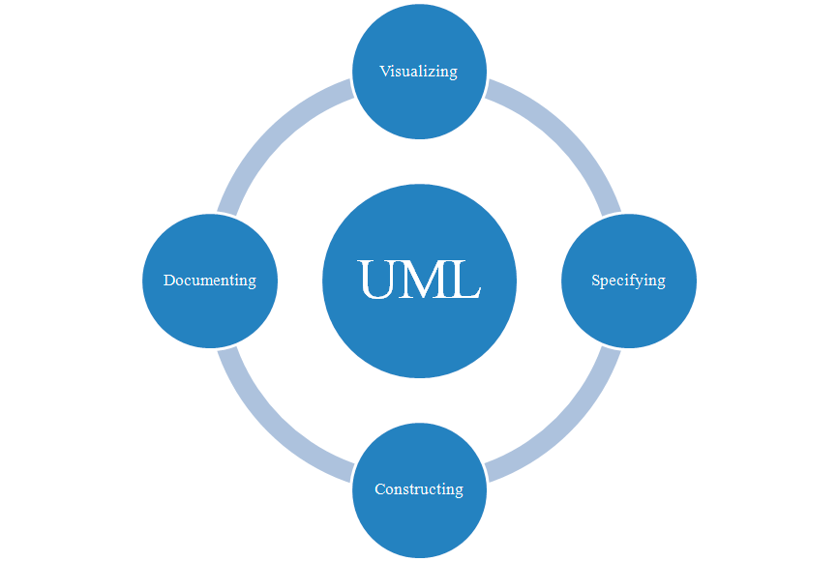
Overview of UML

Slide 4
The UML is a Language
A language provides a vocabulary and the rules for combining words in that vocabulary for the purpose of communication.
A modeling language is a language whose vocabulary and rules focus on the conceptual and physical representation of the system.
A modeling language like UML is thus a standard language for software blueprints.

Slide 5
The UML is a Language
The vocabulary and rules of a language such as the UML tell you how to create and read well-formed models.
But they don’t tell you what models you should create and when you should create them.
That’s the role of software development process.
A well-defined process will guide you in deciding what artifacts to produce, what activities and what workers to use to create them and manage them.

Slide 6
UML is a Language for Visualizing
For many programmers, the distance between thinking of an implementation and then converting it out into code is close to zero.
You think it, you code it.
some things are best represented in code.
Text is a wonderfully minimal and direct way to write expressions and algorithms.

Slide 7
UML is a Language for Visualizing
The programmer is still doing some modeling.
He or she may even sketch out a few ideas on a white board or paper. There are several problems with this.

Slide 8
UML is a Language for Visualizing
Communicating those conceptual models to others is error-prone unless everyone involved speaks the same language.
There are some things about a software system you can’t understand unless you build models.
If the developer who cut the code never wrote down the models that are in his or her head, that information would be lost forever or, at best, only partially re-creatable from the implementation, once that developer moved on

Slide 9
UML is a Language for Specifying
Specifying means building models that are precise, unambiguous and complete.
The UML addresses the specification of all the important analysis, design and implementation decisions that must be made in developing and deploying a software-intensive system.

Slide 10
UML is a Language for Specifying
The UML is not a visual programming language, but its models can be directly connected to a variety of programming languages.
This means that it is possible to map from a model in the UML to a programming language such as Java, C++ or VB, or even to tables in a relational database or object-oriented database.

Slide 11
UML is a Language for Specifying
This mapping permits forward engineering: The generation of code from a UML model into a programming language.
The reverse is also possible: you can reconstruct a model from an implementation back into the UML which is known as reverse engineering.

Slide 12
UML is a Language for Specifying
Combining these two paths of forward code generation and reverse engineering yields round-trip engineering, meaning the ability to work with in either a graphical or a textual view, while the tools keep the two views consistent.

Slide 13
UML is a Language for Documenting
A healthy software organization produces all sorts of artifacts in addition to raw executable code. These artifacts include:
Requirements
Architecture
Design
Source Code
Project Plans
Tests
Prototypes
Releases

Slide 14
Where can UML be used? (Application domains of UML)
UML can be used in domains such as:
Enterprise information systems
Banking and Financial services
Telecommunications
Transportation
Defense
Retail
Medical electronics
Scientific
Distributed web-based services

