Slide 1
Basic Structural Modeling
UNIT – II
Part - 1

Slide 2
Topics to be Covered
Classes
Relationships
Common Mechanisms
Diagrams

Slide 3
Classes

Slide 4
Introduction
Modeling a system involves identifying the things that are important to your particular view.
These things form the vocabulary of the system you are modeling.
For ex- if you are building a house, things like walls, doors, windows, cabinets, and lights are some of the things that will be important to you as a home owner.

Slide 5
Introduction
The UML provides a graphical representation of class.
This notation permits you to visualize an abstraction apart from any specific programming language and in a way that lets you emphasize the most important parts of an abstraction: its name, attributes, and operations.

Slide 6
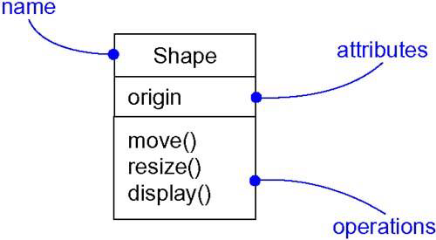
Introduction

Slide 7
Terms and Concepts
A class is a description of a set of objects that share the same attributes, operations, relationships, and semantics.
Graphically, a class is rendered as a rectangle.

Slide 8
Names
Every class must have a name that distinguishes it from other classes.
A name is a textual string.
That name alone is known as a simple name; a path name is the class name prefixed by the name of the package in which that class lives.

Slide 9
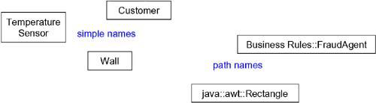
Names

Slide 10
Attributes
An attribute is a named property of a class that describes a range of values that instances of the property may hold.
A class may have any number of attributes or no attributes at all.
An attribute represents some property of the thing you are modeling that is shared by all objects of that class.
Graphically, attributes are listed in a compartment just below the class name.

Slide 11
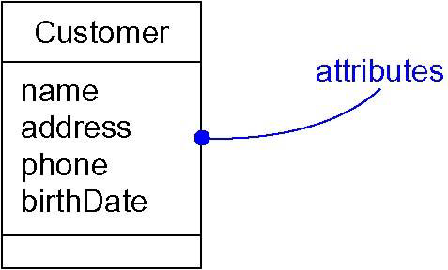
Attributes
Attributes may be drawn showing only their names, as shown in below Figure.

Slide 12
Operations
An operation is a service provided by the objects of a class.
An operation is the abstraction of what can be done to an object.
Operations are shared by all the objects.
A class may have any number of operations or no operations at all.

Slide 13
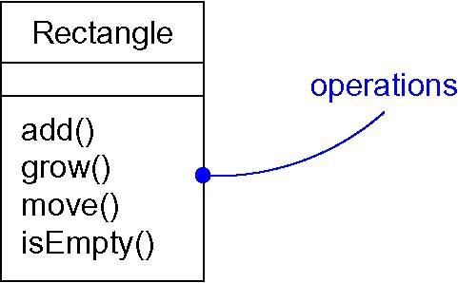
Operations
Operations are listed in a compartment below the attributes of the class.
Operations are listed as simple names.

Slide 14
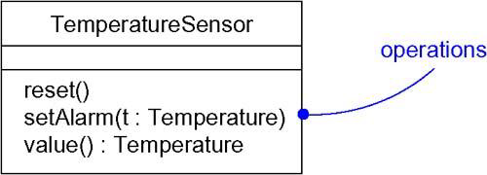
Operations
Operations can also be listed by stating its signature, covering the name, type, and default value of all parameters and (in the case of functions) a return type, as shown below.

Slide 15
Organizing Attributes and Operations
To better organize long lists of attributes and operations, you can also prefix each group with a descriptive category by using stereotypes.
You can explicitly specify that there are more attributes or properties than shown by ending each list with an ellipsis ("...").

Slide 16
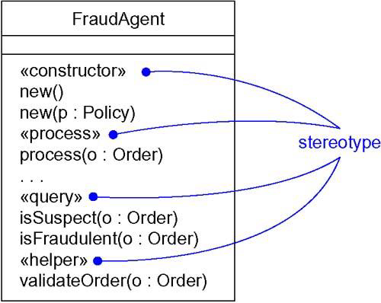
Organizing Attributes and Operations

Slide 17
Responsibilities
The responsibilities of a class specify the contract between the class and its objects.
The responsibilities of a class represent its features (attributes and operations).
For example, the responsibility of a wall class is to represent the height, width and thickness of the wall.
Responsibilities are represented as text in a compartment at the bottom of the class.

Slide 18
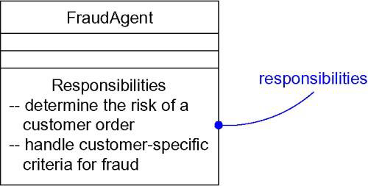
Responsibilities

Slide 19
Common Modeling Techniques
There are four types of modeling techniques for classes.
Modeling the Vocabulary of a System
Modeling the Distribution of Responsibilities in a System
Modeling Nonsoftware Things
Modeling Primitive Types

Slide 20
1. Modeling the Vocabulary of a System
To model the vocabulary of a system,
Identify those things that users or implementers use to describe the problem or solution. Use use case-based analysis to help find these abstractions.
For each abstraction, identify a set of responsibilities.
Provide the attributes and operations that are needed to carry out these responsibilities for each class.

Slide 21
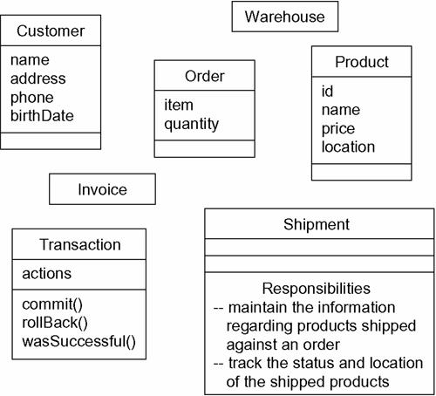
1. Modeling the Vocabulary of a System

Slide 22
2. Modeling the Distribution of Responsibilities in a System
To model the distribution of responsibilities in a system,
Identify a set of classes that work together closely to carry out some behavior.
Identify a set of responsibilities for each of these classes.
Look at this set of classes as a whole, split classes that have too many responsibilities into smaller abstractions, collapse tiny classes that have trivial responsibilities into larger ones, and reallocate responsibilities so that each abstraction reasonably stands on its own.
Consider the ways in which those classes collaborate with one another, and redistribute their responsibilities accordingly so that no class within a collaboration does too much or too little.

Slide 23
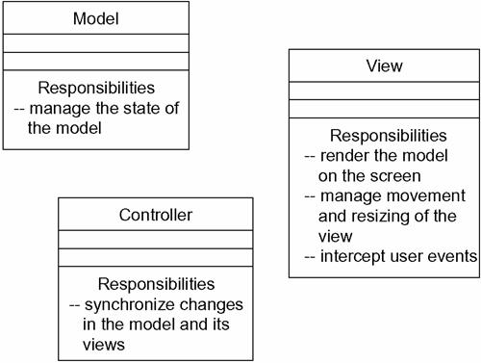
2. Modeling the Distribution of Responsibilities in a System

Slide 24
3. Modeling Nonsoftware Things
To model nonsoftware things,
Model the thing you are abstracting as a class.
If you want to distinguish these things from the UML's defined building blocks, create a new building block by using stereotypes to specify these new semantics.
If the thing you are modeling is some kind of hardware that itself contains software, consider modeling it as a kind of node.

Slide 25
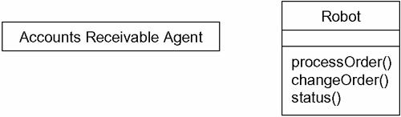
3. Modeling Nonsoftware Things

Slide 26
4. Modeling Primitive Types
To model primitive types,
Model the thing you are abstracting as a type, which is rendered using class notation with the appropriate stereotype.
If you need to specify the range of values associated with this type, use constraints.

Slide 27
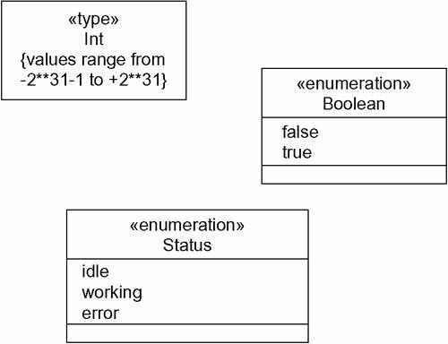
4. Modeling Primitive Types

