Slide 1
Advanced Relationships

Slide 2
Topics to be covered
Getting Started
Terms and Concepts
Common Modeling Techniques

Slide 3
Getting Started
Dependencies, generalizations, and associations are the most common relationships you'll encounter when modeling software-intensive systems.
You need a number of advanced features of these relationships in order to capture the details of many systems - details that are important for you to consider so that you avoid real flaws in your design.

Slide 4
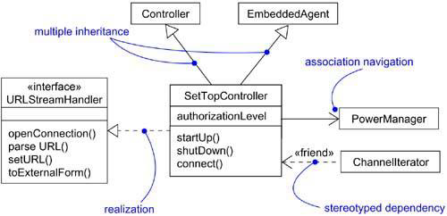
Getting Started
The UML provides a representation for a number of advanced properties, as shown in below figure.

Slide 5
Getting Started
The above notation permits you to visualize, specify, construct, and document webs of relationships to any level of detail you wish, even sufficient to support forward and reverse engineering of models and code.

Slide 6
Terms and Concepts
A relationship is a connection among things.
In object-oriented modeling, the four most important relationships are dependencies, generalizations, associations, and realizations.
Graphically, a relationship is rendered as a path, with different kinds of lines used to distinguish the different relationships.

Slide 7
Dependency
A dependency is a using relationship, specifying that a change in the specification of one thing may affect another thing that uses it, but not necessarily the reverse.
Graphically, a dependency is rendered as a dashed line, directed to the thing that is depended on.
Apply dependencies when you want to show one thing using another.

Slide 8
Dependency
If you want to specify a shade of meaning, the UML defines a number of stereotypes that may be applied to dependency relationships.
There are 17 such stereotypes, all of which can be organized into six groups.

Slide 9
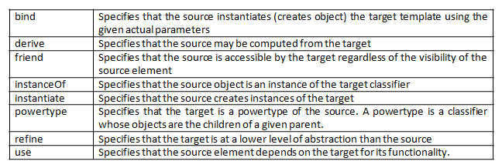
Dependency
There are eight stereotypes that apply to dependency relationships among classes and objects in class diagrams.

Slide 10
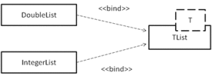



Dependency

Slide 11


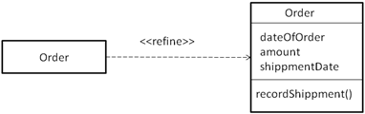

Dependency

Slide 12



Dependency
There are two stereotypes that apply to dependency relationships among packages.

Slide 13



Dependency
There are two stereotypes apply to dependency relationships among use cases:

Slide 14




Dependency
There are three stereotypes when modeling interactions among objects:

Slide 15
Dependency
One stereotype you'll encounter in the context of state machines is:

Slide 16

Dependency
One stereotype that you'll encounter in the context of organizing the elements of your system into subsystems and models is

Slide 17
Generalization
A generalization is a relationship between a general thing (called the superclass or parent) and a more specific kind of that thing (called the subclass or child).
A subclass in the generalization relationship automatically inherits the state and behavior of the superclass.
The generalization relationship is also known as the “is-a” relationship.
If a class has only one parent, such inheritance is known as single inheritance and if a class has one or more parents, such inheritance is known as multiple inheritance.

Slide 18
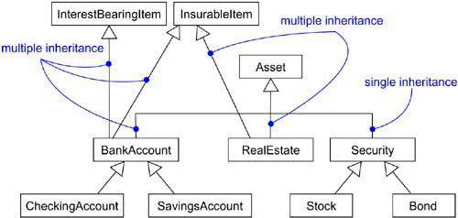
Generalization
Single and Multiple inheritance

Slide 19
Generalization
To represent extra semantics in a generalization relationship, UML provides one stereotype and four constraints.
The stereotype on generalization relationship is:

Slide 20
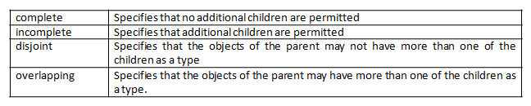
Generalization
There are four standard constraints that apply to generalization relationships.

Slide 21
Association
An association is a structural relationship, specifying that objects of one thing are connected to objects of another.
The association relationship can represent either physical or logical connections between things.
Graphically, an association is rendered as a solid line connecting the same or different classes.
You use associations when you want to show structural relationships.

Slide 22
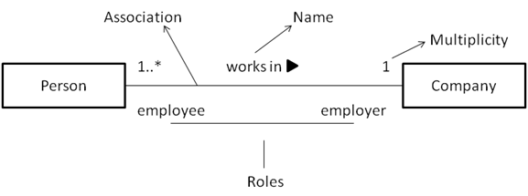
Association
There are four basic adornments that apply to an association: a name, the role at each end of the association, the multiplicity at each end of the association, and aggregation.

Slide 23
Association
Over these basic features, there are other advanced features like: navigation, visibility, qualification, interface specifier, composition and association classes.

Slide 24
Navigation
Given an association between two things, we can navigate from one thing to another and vice versa.
By default the navigation of an association is bidirectional.
In some cases we may need to navigate in only one direction.
You can explicitly represent the direction of navigation by adorning an association with an arrowhead pointing to the direction of traversal.

Slide 25
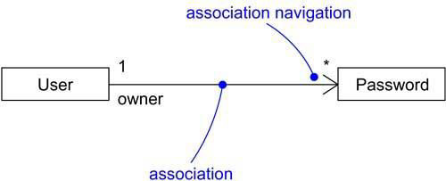
Navigation

Slide 26
Visibility
Given an association, we can navigate from one object to another.
In some situations we may want to limit the visibility (access) of an object to the objects outside the association relationship.
To limit the visibility of an object, we can use the visibility specifiers: public (+), private (-) and protected (#).

Slide 27
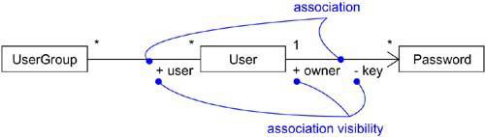
Visibility

Slide 28
Qualification
In binary associations, where two classes are connected together, if one object of a class has to identify a set of instances of another class, we can use qualifiers.
A qualifier is a set of attributes of an association which is used to identify a set of instances of a class.
Each qualifier is represented with a name and type in a rectangle box at the qualified end of the association relationship.

Slide 29

Qualification
For example, a bank object is able to recognize the person (account holder) based on the account number. So, account number is the qualifier which is used to identify an account holder.

Slide 30
Interface Specifier
An interface is a collection of operations that are used to specify a service of class or component; every class may realize many interfaces.
The interfaces realized by a class represent a complete specification of the behavior of that class.
In the context of an association with another target class, a source class may choose to present only part of its face to the world.

Slide 31
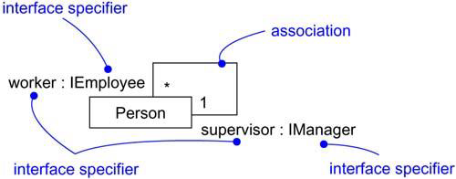
Interface Specifier

Slide 32
Composition
The composition is a flavor of association relationship.
Composition as well as aggregation relationships represent whole-part relationships, in which one thing is a part of the other thing.
There is a simple difference between the association and composition relationships.

Slide 33
Composition
In composition, the lifetime of the part is dependent of the lifetime of the whole thing.
In aggregation, the lifetime of the part is independent of the whole thing.
Composition is graphically represented by adorning the association relationship with a filled diamond head near the whole end.

Slide 34
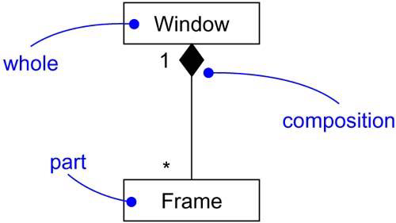

Composition

Slide 35
Association Classes
Sometimes in an association relationship, the association might have attributes or properties like a class does. In such cases, it is modeled as an association class.
An association class in UML is represented with a class icon attached to the association with a dashed line.

Slide 36
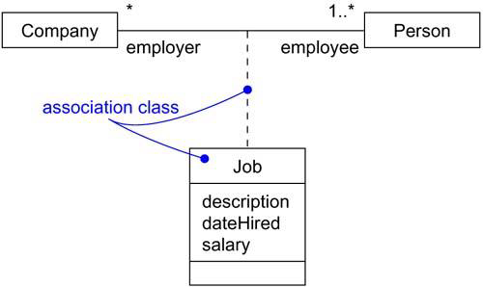
Association Classes

Slide 37
Constraints
Apart from the above advanced features, the UML defines five constraints that may be applied to association relationships.
First, you can distinguish if the association is real or conceptual.
1 | implicit | Specifies that the relationship is not manifest but, rather, is only conceptual

Slide 38
Constraints
Second, you can specify that the objects at one end of an association (with a multiplicity greater than one) are ordered or unordered.
2 | ordered | Specifies that the set of objects at one end of an association are in an explicit order

Slide 39
Constraints
There are three defined constraints that relate to the changeability of the instances of an association.
3 | changeable | Links between objects may be added, removed, and changed freely
4 | addOnly | New links may be added from an object on the opposite end of the association
5 | frozen | A link, once added from an object on the opposite end of the association, may not be modified or deleted

Slide 40
Constraints
Finally, there is one constraint for managing related sets of associations.
6 | xor | Indicates that among a set of associations, only one can be applied for each object

Slide 41
Realization
A realization is a semantic relationship between classifiers in which one classifier specifies a contract that another classifier guarantees to carry out.
Graphically, a realization is rendered as a dashed directed line with a large open arrowhead pointing to the classifier that specifies the contract.

Slide 42
Realization
You'll use realization in two circumstances: in the context of interfaces and in the context of collaborations.

Slide 43
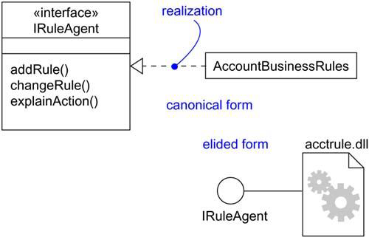
Realization
You'll use realization to specify the relationship between an interface and the class or component that provides an operation or service for it.
Realization of an Interface

Slide 44
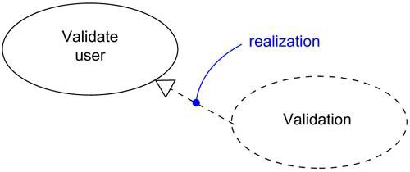
Realization
You'll also use realization to specify the relationship between a use case and the collaboration that realizes that use case.
Realization of a Use Case

Slide 45
Common Modeling Techniques
There is only one type modeling techniques for Advanced Relationships.
Modeling Webs of Relationships

Slide 46
Modeling Webs of Relationships
To model webs of relationships,
Apply use cases and scenarios to find the relationships between the abstractions in the system.
Start by modeling the structural relationships (associations) between the things. These specify the structure of the system.
Then, model the generalization-specialization relationships.

Slide 47
Modeling Webs of Relationships
Finally, after modeling the remaining relationships go for dependency relationships.
After representing all the relationships, transform their basic representation by applying the advanced features to your intent.
Note: It is both undesirable and unnecessary to model all relationships among a set of abstractions in a single diagram.

