Slide 1
Diagrams

Slide 2
Introduction
When you model something, you create a simplification of reality so that you can better understand the system you are developing.
Using the UML, you build your models from basic building blocks, such as classes, interfaces, collaborations, components, nodes, dependencies, generalizations, and associations.

Slide 3
Introduction
Diagrams are the means by which you view these building blocks.
A diagram is a graphical presentation of a set of elements, most often rendered as a connected graph of vertices (things) and arcs (relationships).

Slide 4
Introduction
You use diagrams to visualize your system from different perspectives.
Because no complex system can be understood in its entirety from only one perspective, the UML defines a number of diagrams so that you can focus on different aspects of your system independently.

Slide 5
Getting Started
There are five complementary views that are most important in visualizing, specifying, constructing, and documenting a software architecture: the use case view, the design view, the process view, the implementation view, and the deployment view.
Each of these views involves structural modeling (modeling static things), as well as behavioral modeling (modeling dynamic things).

Slide 6
Getting Started
When you view a software system from any perspective using the UML, you use diagrams to organize the elements of interest.
The UML defines nine kinds of diagrams, which you can mix and match to assemble each view.
For example, the static aspects of a system's implementation view might be visualized using component diagrams; the dynamic aspects of the same implementation view might be visualized using interaction diagrams.
Similarly, the static aspects of a system's database might be visualized using class diagrams; its dynamic aspects might be visualized using collaboration diagrams.

Slide 7
Getting Started
You'll use the UML's diagrams in two basic ways: to specify models from which you'll construct an executable system (forward engineering) and to reconstruct models from parts of an executable system (reverse engineering).

Slide 8
Terms and Concepts
A system is a collection of subsystems organized to accomplish a purpose and described by a set of models.
A subsystem is a grouping of elements, of which some constitute a specification of the behavior offered by the other contained elements.

Slide 9
Terms and Concepts
A model is a semantically closed abstraction of a system, i.e it represents a complete and self consistent simplification of reality, created in order to better understand the system.
A view is a projection into the organization and structure of a system's model, focused on one aspect of that system.
A diagram is the graphical presentation of a set of elements, most often rendered as a connected graph of vertices (things) and arcs (relationships).

Slide 10
Terms and Concepts
In modeling real systems, you'll find yourself creating the same kinds of diagrams, because they represent common views into common models.
You'll view the static parts of a system using one of the four following diagrams.
1. Class diagram
2. Object diagram
3. Component diagram
4. Deployment diagram
You'll view the dynamic parts of a system using one of the four following diagrams.
1. Use case diagram
2. Sequence diagram
3. Collaboration diagram
4. Statechart diagram
5. Activity diagram

Slide 11
Structural Diagrams
UML’s four structural diagrams allow us to model the static aspects of the software system.
Static aspects of the system represent the skeleton of the system.
The static aspects consist of classes, interfaces, collaborations, components and nodes.

Slide 12
Structural Diagrams
UML’s four structural diagrams are organized around the major groups of things we will find when modeling a system:
1 | Class diagram | Classes, interfaces, and collaborations
2 | Object diagram | Objects
3 | Component diagram | Components
4 | Deployment diagram | Nodes

Slide 13
1. Class Diagram
A class diagram shows a set of classes, interfaces, and collaborations and their relationships.
Class diagrams are the most common diagram found in modeling object-oriented systems.
You use class diagrams to illustrate the static design view of a system.
Class diagrams that include active classes are used to address the static process view of a system.

Slide 14
2. Object Diagram
An object diagram shows a set of objects and their relationships.
You use object diagrams to illustrate data structures, the static snapshots of instances of the things found in class diagrams.
Object diagrams address the static design view or static process view of a system just as do class diagrams, but from the perspective of real or prototypical cases.

Slide 15
3. Component Diagram
A component diagram shows a set of components and their relationships.
You use component diagrams to illustrate the static implementation view of a system.
Component diagrams are related to class diagrams in that a component typically maps to one or more classes, interfaces, or collaborations.

Slide 16
4. Deployment Diagram
A deployment diagram shows a set of nodes and their relationships.
You use deployment diagrams to illustrate the static deployment view of an architecture.
Deployment diagrams are related to component diagrams in that a node typically encloses one or more components.

Slide 17
Behavioral Diagrams
UML’s five behavioral diagrams allow us to model the dynamic aspects of the software system.
The dynamic aspects can be thought of as the changing parts in the system.
The dynamics of a system can be seen as messages between objects or components moving from one place to another.

Slide 18
Behavioral Diagrams
UML’s behavioral diagrams are organized around the major ways you can model the dynamics of a system:
1 | Use case diagram | Organizes the behaviors of the system
2 | Sequence diagram | Focused on the time ordering of messages
3 | Collaboration diagram | Focused on the structural organization of objects that send and receive messages
4 | Statechart diagram | Focused on the changing state of a system driven by events
5 | Activity diagram | Focused on the flow of control from activity to activity

Slide 19
1. Use Case Diagram
A use case diagram shows a set of use cases and actors (a special kind of class) and their relationships.
You apply use case diagrams to illustrate the static use case view of a system.
Use case diagrams are especially important in organizing and modeling the behaviors of a system.

Slide 20
2. Sequence Diagram
A sequence diagram is an interaction diagram that emphasizes the time ordering of messages.
A sequence diagram shows a set of objects and the messages sent and received by those objects.
The objects are typically named or anonymous instances of classes, but may also represent instances of other things, such as collaborations, components, and nodes.
You use sequence diagrams to illustrate the dynamic view of a system.

Slide 21
3. Collaboration Diagram
A collaboration diagram is an interaction diagram that emphasizes the structural organization of the objects that send and receive messages.
A collaboration diagram shows a set of objects, links among those objects, and messages sent and received by those objects.
The objects are typically named or anonymous instances of classes, but may also represent instances of other things, such as collaborations, components, and nodes.
You use collaboration diagrams to illustrate the dynamic view of a system.

Slide 22
4. Statechart Diagram
A statechart diagram shows a state machine, consisting of states, transitions, events, and activities.
You use statechart diagrams to illustrate the dynamic view of a system.
They are especially important in modeling the behavior of an interface, class, or collaboration.
Statechart diagrams emphasize the event-ordered behavior of an object, which is especially useful in modeling reactive systems.

Slide 23
5. Activity Diagram
An activity diagram shows the flow from activity to activity within a system.
An activity shows a set of activities, the sequential or branching flow from activity to activity, and objects that act and are acted upon.
You use activity diagrams to illustrate the dynamic view of a system.
Activity diagrams are especially important in modeling the function of a system.
Activity diagrams emphasize the flow of control among objects.

Slide 24
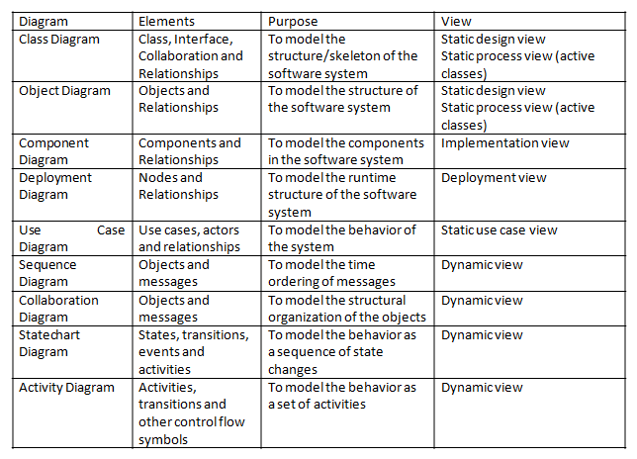

Slide 25
Common Modeling Techniques
There are three types of modeling techniques for diagrams.
Modeling Different Views of a System
Modeling Different Levels of Abstraction
Modeling Complex Views

Slide 26
Modeling Different Views of a System
To model a system from different views,
Decide which views you need to best express the architecture of your system and to expose the technical risks to your project.
For each of these views, decide which artifacts you need to create to capture the essential details of that view.

Slide 27
Modeling Different Views of a System
As part of your process planning, decide which of these diagrams you'll want to put under some sort of formal or semi-formal control.
Allow room for diagrams that are thrown away.

Slide 28
Modeling Different Views of a System
For example, if you are modeling a simple monolithic application that runs on a single machine, you might need only the following diagrams.
Use case view | Use case diagrams
Design view | Class diagrams (for structural modeling), Interaction diagrams (for behavioral modeling)
Process view | None required
Implementation view | None required
Deployment view | None required

Slide 29
Modeling Different Views of a System
Finally, if you are modeling a complex, distributed system, you'll need to employ the full range of the UML's diagrams in order to express the architecture of your system and the technical risks to your project, as in the following.

Slide 30
Modeling Different Views of a System
Use case view | Use case diagrams Activity diagrams (for behavioral modeling)
Design view | Class diagrams (for structural modeling), Interaction and Statechart diagrams (for behavioral modeling)
Process view | Class diagrams (for structural modeling), Interaction diagrams (for behavioral modeling)
Implementation view | Component diagram
Deployment view | Deployment diagrams

Slide 31
Modeling Different Levels of Abstraction
To model a system at different levels of abstraction by presenting diagrams with different levels of detail,
Consider the needs of your readers, and start with a given model.
If your reader is using the model to construct an implementation, she'll need diagrams that are at a lower level of abstraction, which means that they'll need to reveal a lot of detail.

Slide 32
Modeling Different Levels of Abstraction
Depending on where you land in this spectrum of low-to-high levels of abstraction, create a diagram at the right level of abstraction by hiding or revealing the following four categories of things from your model:
Building blocks and relationships:- Hide those that are not relevant to the intent of your diagram or the needs of your reader.
Adornments:- Reveal only the adornments of these building blocks and relationships that are essential to understanding your intent.

Slide 33
Modeling Different Levels of Abstraction
Flow:- In the context of behavioral diagrams, expand only those messages or transitions that are essential to understanding your intent.
Stereotypes:- In the context of stereotypes used to classify lists of things, such as attributes and operations, reveal only those stereotyped items that are essential to understanding your intent.

Slide 34
Modeling Different Levels of Abstraction
To model a system at different levels of abstraction by creating models at different levels of abstraction,
Consider the needs of your readers and decide on the level of abstraction that each should view, forming a separate model for each level.

Slide 35
Modeling Different Levels of Abstraction
In general, populate your models that are at a high level of abstraction with simple abstractions and your models that are at a low level of abstraction with detailed abstractions.
In practice, if you follow the five views of an architecture, there are four common situations you'll encounter when modeling a system at different levels of abstraction:

Slide 36
Modeling Different Levels of Abstraction
Use cases and their realization:- Use cases in a use case model will trace to collaborations in a design model.
Collaborations and their realization:- Collaborations will trace to a society of classes that work together to carry out the collaboration.
Components and their design:- Components in an implementation model will trace to the elements in a design model.
Nodes and their components:- Nodes in a deployment model will trace to components in an implementation model.

Slide 37
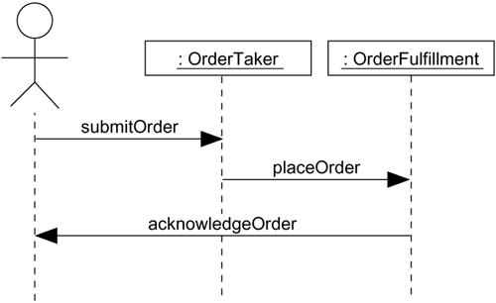
Interaction Diagram at a High Level of Abstraction

Slide 38
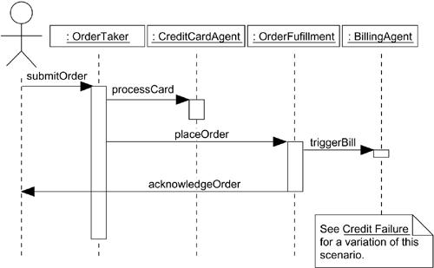
Interaction Diagram at a Low Level of Abstraction

Slide 39
Modeling Complex Views
To model complex views,
First, hide the unnecessary details using the notations of UML.
Still if the diagrams are complex, consider grouping the related elements using packages.

Slide 40
Modeling Complex Views
Still, if the diagrams are complex, consider using notes and different colors for the elements to draw the attention of the readers.
Still, if the diagrams are complex, print it in its entirety and hang it on a convenient large wall.

