Slide 1
Packages

Slide 2
Topics to be covered
Introduction
Getting Started
Terms and Concepts
Common Modeling Techniques

Slide 3
Introduction
In the UML, the package is a general purpose mechanism for organizing modeling elements into groups.
You use packages to arrange your modeling elements into larger chunks that you can manipulate as a group.
You can control the visibility of these elements so that some things are visible outside the package while others are hidden.
You can also use packages to present different views of your system's architecture.

Slide 4
Getting Started
In the UML, the chunks that organize a model are called packages.
A package is a general purpose mechanism for organizing elements into groups.
Packages help you organize the elements in your models so that you can more easily understand them.
Packages also control access to their contents so that you can control the seams in your system's architecture.

Slide 5
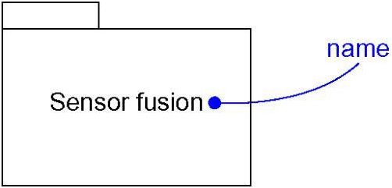
Getting Started
The UML provides a graphical representation of package, as shown in below figure.
This notation permits you to visualize groups of elements that can be manipulated as a whole and in a way that lets you control the visibility of and access to individual elements.

Slide 6
Terms and Concepts
A package is a general-purpose mechanism for organizing elements into groups.
Graphically, a package is rendered as a tabbed folder.

Slide 7
Names
Every package must have a name that distinguishes it from other packages.
A name is a textual string. That name alone is known as a simple name; a path name is the package name prefixed by the name of the package in which that package lives, if any.
A package is typically drawn showing only its name, as shown in below figure.
Like classes, you may draw packages adorned with tagged values or with additional compartments to expose their details.

Slide 8
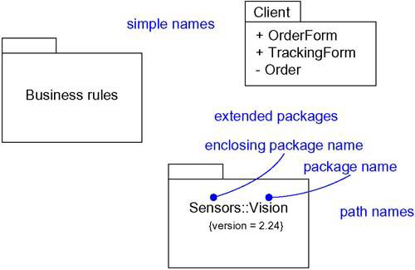
Names

Slide 9
Owned Elements
A package may own other elements, including classes, interfaces, components, nodes, collaborations, use cases, diagrams, and even other packages.
Owning is a composite relationship, which means that the element is declared in the package.
If the package is destroyed, the element is destroyed.
Every element is uniquely owned by exactly one package.

Slide 10
Owned Elements
A package forms a namespace, which means that elements of the same kind must be named uniquely within the context of its enclosing package.
Elements of different kinds may have the same name within a package.
Packages may own other packages. This means that it's possible to decompose your models hierarchically.

Slide 11
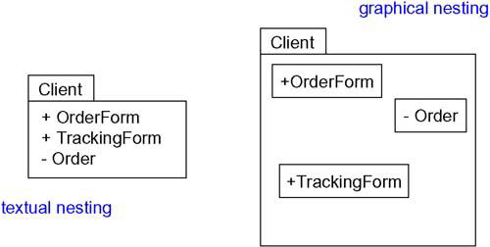
Owned Elements

Slide 12
Visibility
You can control the visibility of the elements owned by a package just as you can control the visibility of the attributes and operations owned by a class.
An element owned by a package is public, which means that it is visible to the contents of any package that imports the element's enclosing package.
Protected elements can only be seen by children.
Private elements cannot be seen outside the package in which they are declared.

Slide 13
Visibility
You specify the visibility of an element owned by a package by prefixing the element's name with an appropriate visibility symbol.
You can designate an element as public, protected and private, rendered by prefixing the element's name with +, # and – symbols, respectively.
Protected elements are visible only to packages that inherit from another package.
Private elements are not visible outside the package at all.

Slide 14
Importing and Exporting
Importing grants a one-way permission for the elements in one package to access the elements in another package.
In the UML, you model an import relationship as a dependency adorned with the stereotype import.
By packaging your abstractions into meaningful chunks and then controlling their access by importing, you can control the complexity of large numbers of abstractions.
The public parts of a package are called its exports.

Slide 15
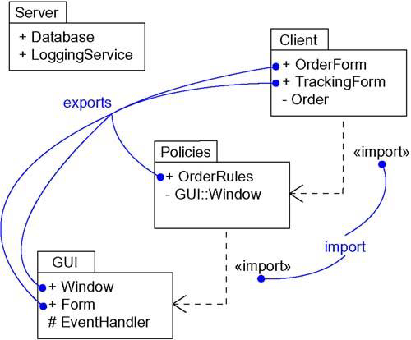
Importing and Exporting

Slide 16
Generalization
There are two kinds of relationships you can have between packages:
import and access dependencies - used to import into one package elements exported from another.
generalizations - used to specify families of packages.

Slide 17
Generalization
Generalization among packages is very much like generalization among classes.
Packages involved in generalization relationships follow the same principle of substitutability as do classes.
A specialized package (such as WindowsGUI) can be used anywhere a more general package (such as GUI) is used.

Slide 18
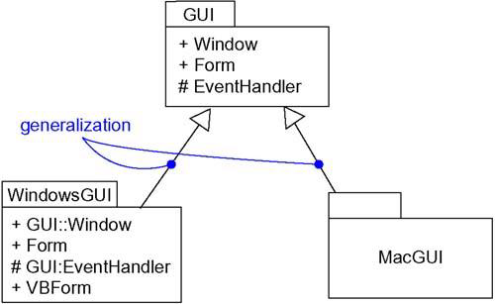
Generalization

Slide 19
Standard Elements
All of the UML's extensibility mechanisms apply to packages.
You'll use tagged values to add new package properties (such as specifying the author of a package) and stereotypes to specify new kinds of packages (such as packages that encapsulate operating system services).

Slide 20
Standard Elements
The UML defines five standard stereotypes that apply to packages.
The UML does not specify icons for any of these stereotypes.
In addition to these five package stereotypes, you'll also use dependencies designated using the standard stereotype import.
1 | facade | Specifies a package that is only a view on some other package
2 | framework | Specifies a package consisting mainly of patterns
3 | stub | Specifies a package that serves as a proxy for the public contents of another package
4 | subsystem | Specifies a package representing an independent part of the entire system being modeled
5 | system | Specifies a package representing the entire system being modeled

Slide 21
Common Modeling Techniques
There are two types of modeling techniques for packages.
Modeling Groups of Elements
Modeling Architectural Views

Slide 22
Modeling Groups of Elements
To model groups of elements,
Scan the modeling elements in a particular architectural view and look for clumps defined by elements that are conceptually or semantically close to one another.
Surround each of these clumps in a package.

Slide 23
Modeling Groups of Elements
For each package, distinguish which elements should be accessible outside the package. Mark them public, and all others protected or private. When in doubt, hide the element.
Explicitly connect packages that build on others via import dependencies.
In the case of families of packages, connect specialized packages to their more general part via generalizations.

Slide 24
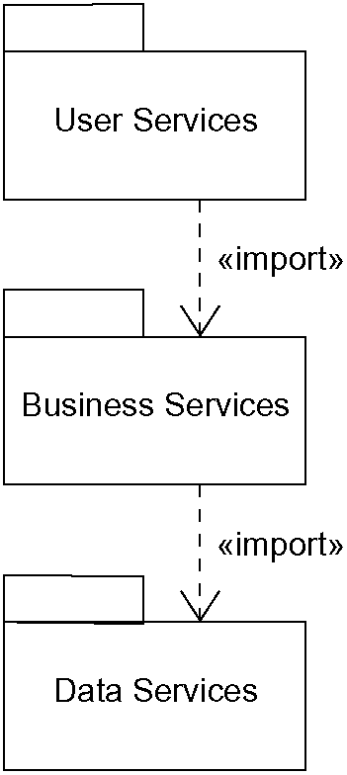
Modeling Groups of Elements

Slide 25
Modeling Architectural Views
To model architectural views,
Identify the set of architectural views that are significant in the context of your problem.
Place the elements (and diagrams) that are necessary and sufficient to visualize, specify, construct, and document the semantics of each view into the appropriate package.
As necessary, further group these elements into their own packages.
There will typically be dependencies across the elements in different views.

Slide 26
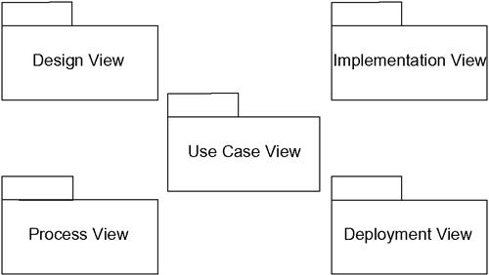
Modeling Architectural Views

