Slide 1
Object Diagram

Slide 2
Topics to be covered
Getting Started
Terms and Concepts
Common Modeling Techniques

Slide 3
Introduction
Object diagrams model the instances of things contained in class diagrams.
An object diagram shows a set of objects and their relationships at a point in time.
You use object diagrams to model the static design view or static process view of a system.
It involves modeling a snapshot of the system at a moment in time and rendering a set of objects, their state, and their relationships.

Slide 4
Introduction
Object diagrams are not only important for visualizing, specifying, and documenting structural models, but also for constructing the static aspects of systems through forward and reverse engineering.

Slide 5
Getting Started
With the UML, you use class diagrams to visualize the static aspects of your system's building blocks.
You use interaction diagrams to visualize the dynamic aspects of your system, consisting of instances of these building blocks and messages dispatched among them.

Slide 6
Getting Started
An object diagram covers a set of instances of the things found in a class diagram.
An object diagram expresses the static part of an interaction, consisting of the objects that collaborate, but without any of the messages passed among them.
In both cases, an object diagram freezes a moment in time.

Slide 7
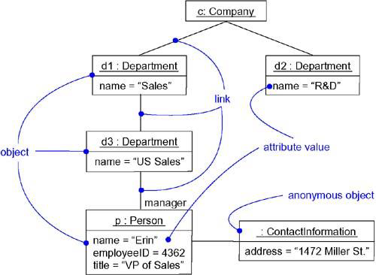
Getting Started

Slide 8
Terms and Concepts
An object diagram is a diagram that shows a set of objects and their relationships at a point in time.
Graphically, an object diagram is a collection of vertices and arcs.

Slide 9
Common Properties
An object diagram is a special kind of diagram and shares the same common properties as all other diagrams. i.e, a name and graphical contents that are a projection into a model.

Slide 10
Contents
Object diagrams commonly contain
Objects
Links
Like all other diagrams, object diagrams may contain notes and constraints.
Object diagrams may also contain packages or subsystems, both of which are used to group elements of your model into larger chunks.
Sometimes, you'll want to place classes in your object diagrams, as well, especially when you want to visualize the classes behind each instance.

Slide 11
Common Uses
You use object diagrams to model the static design view or static process view of a system just as you do with class diagrams.
This view primarily supports the functional requirements of a system.
When you model the static design view or static process view of a system, you typically use object diagrams in one way:
To model object structures

Slide 12
Common Modeling Techniques
There are two types of modeling techniques for object diagrams.
Modeling Object Structures
Forward and Reverse Engineering

Slide 13
Modeling Object Structures
To model an object structure,
First, identify the function or behavior or part of a system you want to model as collection of classes, interfaces and other things.
For each function or mechanism identify the classes and interfaces that collaborate and also identify the relationships between them.

Slide 14
Modeling Object Structures
Consider a scenario (context) that walks through this mechanism and freeze at a moment in time and identify the participating objects.
Represent the state of objects by listing out the attributes and their values.
Represent the links between objects which are instances of associations.

Slide 15
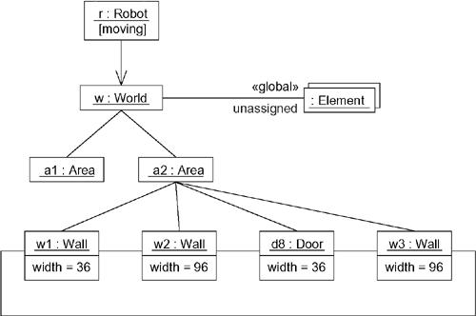
Modeling Object Structures

Slide 16
Forward Engineering
Forward engineering (the creation of code from a model) an object diagram is theoretically possible but pragmatically of limited value.
In an object-oriented system, instances are things that are created and destroyed by the application during run time.
Therefore, you can't exactly instantiate these objects from the outside.

Slide 17
Reverse Engineering
To reverse engineer an object diagram,
Chose the target you want to reverse engineer.
Using a tool or simply walking through a scenario, stop execution at a certain moment in time.
Identify the objects that collaborate with each other and represent them in an object diagram.

Slide 18
Reverse Engineering
As necessary to understand their semantics, expose these object's states.
As necessary to understand their semantics, identify the links that exist among these objects.
Expose the links among the objects, representing instances of association among them.

