Slide 1
Unit IV: Basic Behavioral Modeling
Interactions

Slide 2
Topics to be covered
Getting Started
Terms and Concepts
Common Modeling Techniques

Slide 3
Introduction
In every interesting system, objects don't just sit idle; they interact with one another by passing messages.
An interaction is a behavior that comprises a set of messages exchanged among a set of objects within a context to accomplish a purpose.
We use interactions to model the dynamic aspect of collaborations, representing societies of objects playing specific roles.

Slide 4
Introduction
These roles represent prototypical instances of classes, interfaces, components, nodes, and use cases.
We can model each interaction in two ways:
by emphasizing its time ordering of messages.
by emphasizing its sequencing of messages in the context of some structural organization of objects.
Well-structured interactions are like well-structured algorithms - efficient, simple, adaptable, and understandable.

Slide 5
Getting Started
In the UML, we model the static aspects of a system by using elements such as class diagrams and object diagrams.
These diagrams visualize, specify, construct, and document the things that live in your system, including classes, interfaces, components, nodes, and use cases and their instances, together with the way those things sit in relationship to one another.

Slide 6
Getting Started
In the UML, we model the dynamic aspects of a system by using interactions.
Interactions contain messages that are exchanged between objects.
A message can be an invocation of an operation or a signal.
The messages may also include creation and destruction of other objects.

Slide 7
Getting Started
We use interactions to model the flow of control within an operation, a class, a component, a use case, or the system as a whole.
Using interaction diagrams, we can model these flows in two ways:
By focusing on how the messages are dispatched across time.
By focusing on the structural relationships between objects and then consider how the messages are passed between the objects.

Slide 8
Getting Started
The UML provides a graphical representation of messages, as shown in below figure.
This notation permits you to visualize a message in a way that we emphasize its most important parts: its name, parameters (if any), and sequence.
Graphically, a message is rendered as a directed line and includes the name of its operation.

Slide 9
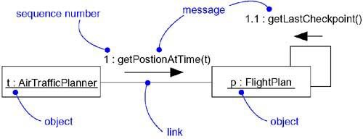
Getting Started
Fig: Messages, Links, and Sequencing

Slide 10
Terms and Concepts
An interaction is a behavior that contains a set of messages exchanged among a set of objects within a context to accomplish a purpose.
A message is a specification of a communication between objects that conveys information with the expectation that the activity will succeed.

Slide 11
Context
We may find an interaction wherever objects are linked to one another.
We'll find interactions in the collaboration of objects that exist in the context of your system or subsystem as a whole.
We will also find interactions in the context of an operation.
The parameters of an operation, any variables local to the operation, and any objects global to the operation (but still visible to the operation) may interact with one another to carry out the algorithm of that operation's implementation.

Slide 12
Context
Finally, you'll find interactions in the context of a class.
We can use interactions to visualize, specify, construct, and document the semantics of a class.

Slide 13
Objects and Roles
The objects that participate in an interaction are either concrete things or prototypical things.
As a concrete thing, an object represents something in the real world.
In the context of an interaction, you may find instances of classes, components, nodes, and use cases.

Slide 14
Objects and Roles
Abstract classes and interfaces may not have any direct instances, we may find instances of these things in an interaction.
Such instances do not represent direct instances of the abstract class or of the interface, but may represent, respectively, indirect instances of any concrete children of the abstract class of some concrete class that realizes that interface.

Slide 15
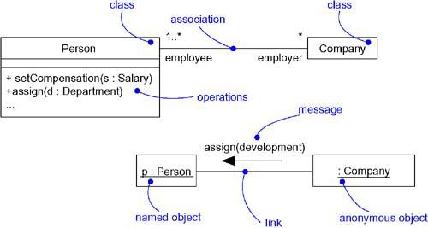
Links
A link is a semantic connection among objects. In general, a link is an instance of an association.

Slide 16
Links
Wherever a class has an association to another class, there may be a link between the instances of the two classes; wherever there is a link between two objects, one object can send a message to the other object.
A link specifies a path along which one object can dispatch a message to another object.
Most of the time, it is sufficient to specify that such a path exists.

Slide 17
Links
If you need to be more precise about how that path exists, you can adorn the appropriate end of the link with any of the following standard stereotypes.
S.No | Stereotype | Specification
1 | association | Specifies that the corresponding object is visible by association
2 | self | Specifies that the corresponding object is visible as it is the dispatcher of the operation
3 | Global | Specifies that the corresponding object is visible as it is in an enclosing scope
4 | Local | Specifies that the corresponding object is visible as it is in a local scope
5 | Parameter | Specifies that the corresponding object is visible as it is a parameter

Slide 18
Messages
A message is the specification of a communication among objects that conveys information with the expectation that activity will ensue.
The receipt of a message instance may be considered an instance of an event.
When you pass a message, the action that results is an executable statement that forms an abstraction of a computational procedure.

Slide 19
Messages
An action may result in a change in state.
In the UML, you can model several kinds of actions.
S.No | Actions | Specification
1 | call | Invokes an operation on an object
2 | return | Returns a value to the caller
3 | send | Sends a signal to the object
4 | create | Creates an object
5 | destroy | Destroys an object

Slide 20
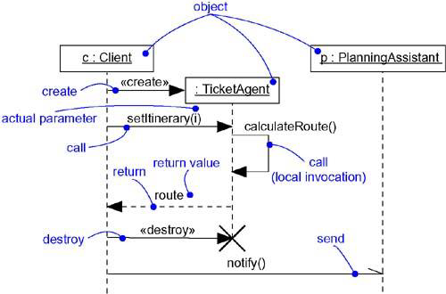
Messages
The UML provides a visual distinction among these kinds of messages, as shown in below figure.
Fig: Messages

Slide 21
Messages
The most common kind of message you'll model is the call, in which one object invokes an operation of another (or the same) object.
An object can't just call any random operation.
When an object calls an operation or sends a signal to another object, you can provide actual parameters to the message.
Similarly, when an object returns control to another object, you can model the return value.

Slide 22
Sequencing
When an object passes a message to another object, the receiving object might in turn send a message to another object, which might send a message to yet a different object, and so on.
This stream of messages forms a sequence.
Any sequence must have a beginning; the start of every sequence is rooted in some process or thread.

Slide 23
Sequencing
Each process and thread within a system defines a distinct flow of control, and within each flow, messages are ordered in sequence by time.
To model the sequence of a message, we can explicitly model the order of the message relative to the start of the sequence by prefixing the message with a sequence number set apart by a colon separator.

Slide 24
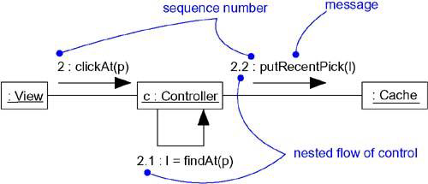
Sequencing
Most commonly, we can specify a procedural or nested flow of control, rendering using a filled solid arrowhead.
Figure: Procedural Sequence

Slide 25
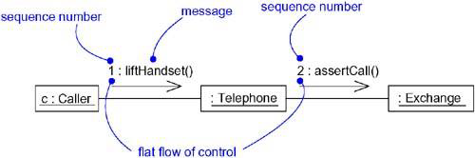
Sequencing
Less common but also possible, you can specify a flat flow of control, rendered using a stick arrowhead.
Figure: Flat Sequence

Slide 26
Sequencing
We will use flat sequences only when modeling interactions in the context of use cases that involve the system as a whole, together with actors outside the system.
In all other cases, we will use procedural sequences, because they represent ordinary, nested operation calls of the type we find in most programming languages.

Slide 27
Creation, Modification, and Destruction
Most of the time, the objects you show participating in an interaction exist for the entire duration of the interaction.
In some interactions, objects may be created and destroyed.
The same is true of links: the relationships among objects may come and go.

Slide 28
Creation, Modification, and Destruction
To specify if an object or link enters and/or leaves during an interaction, you can attach one of the following constraints to the element:
S.No | Constraints | Specification
1 | new | Specifies that the instance or link is created during execution of the enclosing interaction
2 | destroyed | Specifies that the instance or link is destroyed prior to completion of execution of the enclosing interaction
3 | transient | Specifies that the instance or link is created during execution of the enclosing interaction but is destroyed before completion of execution

Slide 29
Creation, Modification, and Destruction
During an interaction, an object typically changes the values of its attributes, its state, or its roles.
You can represent the modification of an object by replicating the object in the interaction.
On a sequence diagram, you'd place each variant of the object on the same lifeline.
In an interaction diagram, you'd connect each variant with a become message.

Slide 30
Representation
When we model an interaction, we typically include both objects and messages.
We can visualize those objects and messages involved in an interaction in two ways:
By emphasizing the time ordering of messages.
By emphasizing the structural organization of the objects that send and receive messages.

Slide 31
Representation
In the UML, the first kind of representation is called a sequence diagram; the second kind of representation is called a collaboration diagram.
Both sequence diagrams and collaboration diagrams are kinds of interaction diagrams.
Sequence diagrams and collaboration diagrams are largely isomorphic, meaning that you can take one and transform it into the other without loss of information.

Slide 32
Representation
There are some visual differences.
Sequence diagrams permit you to model the lifeline of an object. An object's lifeline represents the existence of the object at a particular time, possibly covering the object's creation and destruction.
Collaboration diagrams permit you to model the structural links that may exist among the objects in an interaction.

Slide 33
Common Modeling Techniques
There is one modeling technique for interactions
Modeling a Flow of Control

Slide 34
Modeling a Flow of Control
To model a flow of control
Set the context for the interaction, whether it is the system as a whole, a class or an individual operation.
Identify the objects and their initial properties which participate in the interaction.

Slide 35
Modeling a Flow of Control
Identify the links between objects for communication through messages.
In time order, specify the messages that pass from object to object. Use parameters and return values as necessary.
To add semantics, adorn each object at every moment in time with its state and role.

Slide 36
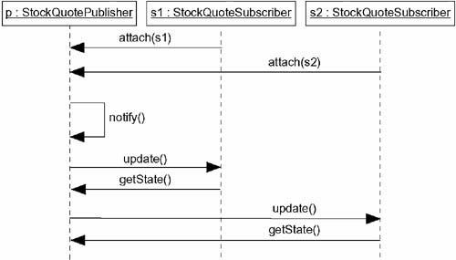
Modeling a Flow of Control
Figure: Flow of Control by Time

Slide 37
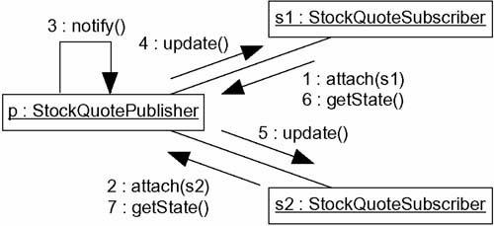
Modeling a Flow of Control
Figure: Flow of Control by Organization

