Slide 1
Interaction Diagrams

Slide 2
Topics to be covered
Getting Started
Terms and Concepts
Common Modeling Techniques

Slide 3
Introduction
Sequence diagrams and collaboration diagrams - both of which are called interaction diagrams- are two of the five diagrams used in the UML for modeling the dynamic aspects of systems.

Slide 4
Introduction
An interaction diagram shows an interaction, consisting of a set of objects and their relationships, including the messages that may be dispatched among them.
A sequence diagram is an interaction diagram that emphasizes the time ordering of messages.
A collaboration diagram is an interaction diagram that emphasizes the structural organization of the objects that send and receive messages.

Slide 5
Introduction
We use interaction diagrams to model the dynamic aspects of a system and also for constructing executable systems through forward and reverse engineering.
Interaction diagrams are used to visualize, specify, construct, and document the dynamics of a particular society of objects, or they may be used to model one particular flow of control of a use case.

Slide 6
Getting Started
In the UML, you model the storyboards by using interaction diagrams.
As shown in below Figure, you can build up the storyboards in two ways:
  by emphasizing the time ordering of messages.
  by emphasizing the structural relationships among the objects that interact.
The diagrams are semantically equivalent; you can convert one to the other without loss of information.

Slide 7
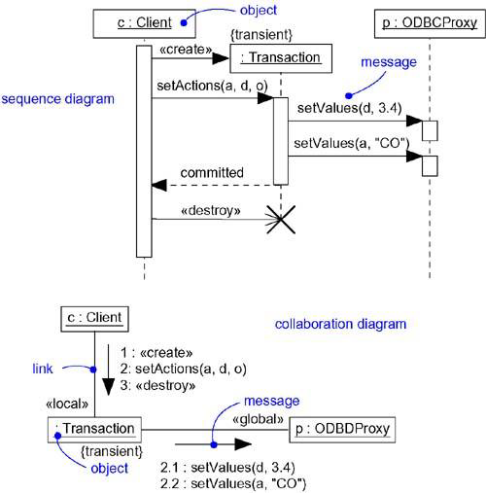
Getting Started

Slide 8
Terms and Concepts
An interaction diagram shows an interaction, consisting of a set of objects and their relationships, including the messages that may be dispatched among them.
A sequence diagram is an interaction diagram that emphasizes the time ordering of messages.
Graphically, a sequence diagram is a table that shows objects arranged along the X-axis and messages, ordered in increasing time, along the Y-axis.

Slide 9
Terms and Concepts
A collaboration diagram is an interaction diagram that emphasizes the structural organization of the objects that send and receive messages.
Graphically, a collaboration diagram is a collection of vertices and arcs.

Slide 10
Common Properties
An interaction diagram shares the same common properties which are common to all the diagrams in UML. They are: a name which identifies the diagram and the graphical contents which are a projection into the model.
What distinguishes an interaction diagram from all other kinds of diagrams is its particular content.

Slide 11
Contents
Interaction diagrams commonly contain
Objects
Links
Messages
Like all other diagrams, interaction diagrams may contain notes and constraints.

Slide 12
Sequence Diagrams
A sequence diagram is one of the two interaction diagrams. The sequence diagram emphasizes on the time ordering of messages.
We form a sequence diagram by first placing the objects that participate in the interaction at the top of your diagram, across the X-axis.
Generally we place the object that initiates the interaction at the left, and increasingly more subordinate objects to the right.

Slide 13
Sequence Diagrams
We place the messages that these objects send and receive along the Y-axis, in order of increasing time from top to bottom.
This gives the user the detail about the flow of control over time.

Slide 14
Sequence Diagrams
Sequence diagrams have two features that distinguish them from collaboration diagrams.
First, there is the object lifeline, which is a vertical dashed line that represents the existence of an object over a period of time. Most of the objects are alive throughout the interaction.
Objects may also be created during the interaction with the receipt of the message stereotyped with create. Objects may also be destroyed during the interaction with the receipt of the message stereotyped with destroy.

Slide 15
Sequence Diagrams
Second, there is focus of control which is represented as a thin rectangle over the life line of the object.
The focus of control represents the points in time at which the object is performing an action.
We can also represent recursion by using a self message.

Slide 16
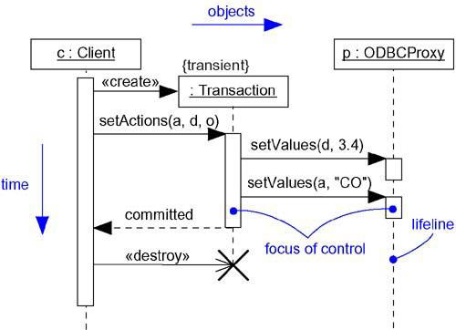
Sequence Diagrams

Slide 17
Collaboration Diagrams
A collaboration diagram is one of the two interaction diagrams. A collaboration diagram emphasizes the organization of the objects that participate in an interaction.
We form a collaboration diagram by first placing the objects that participate in the interaction as the vertices in a graph.
Next, we render the links that connect these objects as the arcs of this graph.

Slide 18
Collaboration Diagrams
Finally, we adorn these links with the messages that objects send and receive.
This gives the user the detail about the flow of control in the context of structural organization of objects that collaborate.
Collaboration diagrams have two features that distinguish them from sequence diagrams.

Slide 19
Collaboration Diagrams
First, there is the path which indicates one object is linked to another, you can attach a path stereotype to the far end of a link.
Second, there is a sequence number to indicate the time ordering of a message by prefixing the message with a number.
We can use Dewey decimal numbering system for the sequence numbers.
  For example a message can be numbered as 1 and the next messages in the nested sequence can be numbered 1.1 and so on.

Slide 20
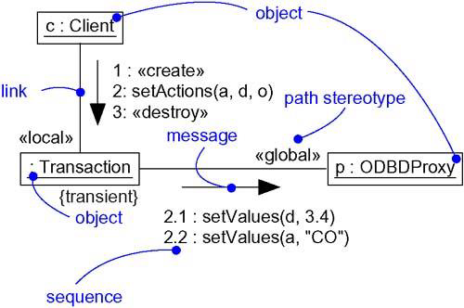
Collaboration Diagrams

Slide 21
Semantic Equivalence
Because they both derive from the same information in the UML's metamodel, sequence diagrams and collaboration diagrams are semantically equivalent.
As a result, you can take a diagram in one form and convert it to the other without any loss of information, as you can see in the previous two figures, which are semantically equivalent.
However, this does not mean that both diagrams will explicitly visualize the same information.

Slide 22
Semantic Equivalence
For example, in the above two figures, the collaboration diagram shows how the objects are linked, whereas the corresponding sequence diagram does not.
Similarly, the sequence diagram shows message return, but the corresponding collaboration diagram does not.
In both cases, the two diagrams share the same underlying model, but each may render some things the other does not.

Slide 23
Common Uses
We use interaction diagrams to model the dynamic aspects (interactions) of the system.
When you use an interaction diagram to model some dynamic aspect of a system, you do so in the context of the system as a whole, a subsystem, an operation, or a class.

Slide 24
Common Uses
When you model the dynamic aspects of a system, you typically use interaction diagrams in two ways.
To model flows of control by time ordering
To model flows of control by organization

Slide 25
Common Modeling Techniques
There are three types modeling techniques for Interaction Diagrams.
Modeling Flows of Control by Time Ordering
Modeling Flows of Control by Organization
Forward and Reverse Engineering

Slide 26
Modeling Flows of Control by Time Ordering
To model a flow of control by time ordering,
Set the context for the interaction, whether it is a system, subsystem, operation or class or one scenario of a use case or collaboration.
Identify the objects that take part in the interaction and lay them out at the top along the x-axis in a sequence diagram.
Set the life line for each object.
Layout the messages between objects from the top along the y-axis.

Slide 27
Modeling Flows of Control by Time Ordering
To visualize the points at which the object is performing an action, use the focus of control.
To specify time constraints, adorn each message with the time and space constraints.
To specify the flow of control in a more formal manner, attach pre and post conditions to each message.

Slide 28
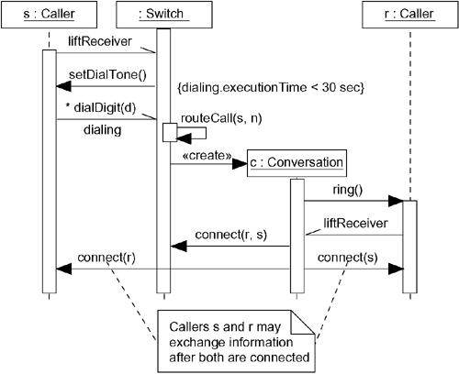
Modeling Flows of Control by Time Ordering

Slide 29
Modeling Flows of Control by Organization
To model a flow of control by organization,
Set the context for the interaction, whether it is a system, subsystem, operation or class or one scenario of a use case or collaboration.
Identify the objects that take part in the interaction and lay them out in a collaboration diagram as the vertices in a graph.
Set the initial properties of each of these objects.
Specify the links among these objects.

Slide 30
Modeling Flows of Control by Organization
Starting with the messages that initiate the interaction, attach each subsequent message to the appropriate link, setting its sequence number, as appropriate. Use Dewey numbering system to specify nested flow of control.
To specify time constraints, adorn each message with the time and space constraints.
To specify the flow of control in a more formal manner, attach pre and post conditions to each message.

Slide 31
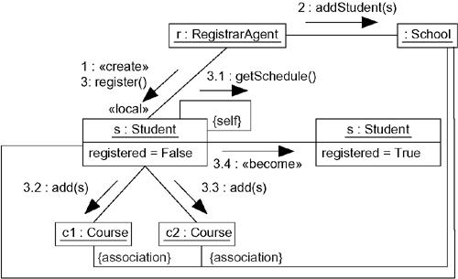
Modeling Flows of Control by Organization

Slide 32
Forward and Reverse Engineering
Forward engineering (the creation of code from a model) is possible for both sequence and collaboration diagrams, especially if the context of the diagram is an operation.
Reverse engineering (the creation of a model from code) is also possible for both sequence and collaboration diagrams, especially if the context of the code is the body of an operation.

