Slide 1
Activity Diagrams

Slide 2
Topics to be covered
Getting Started
Terms and Concepts
Common Modeling Techniques

Slide 3
Introduction
Activity diagrams are one of the five diagrams in the UML for modeling the dynamic aspects of Systems.
An activity diagram is essentially a flowchart, showing flow of control from activity to activity, whereas, the interaction diagrams focus on the flow of control from object to object.

Slide 4
Introduction
Activity diagrams are not only important for modeling the dynamic aspects of a system, but also for constructing executable systems through forward and reverse engineering.

Slide 5
Getting Started
We can model the dynamic aspects using activity diagrams, which focus first on the activities that take place among objects, as shown in below figure.
Activity diagrams are a kind of Pert charts.
An activity diagram is essentially a flowchart that emphasizes the activity that takes place over time.
We can think of an activity diagram as an interaction diagram turned inside out.
An interaction diagram looks at the objects that pass messages; an activity diagram looks at the operations that are passed among objects.

Slide 6
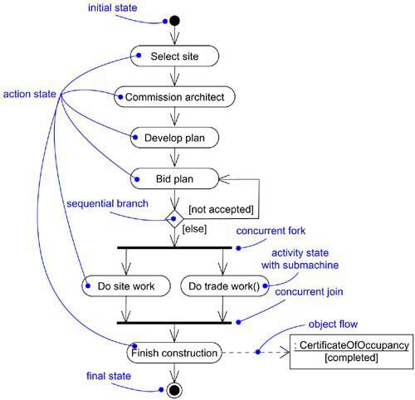
Getting Started

Slide 7
Terms and Concepts
An activity diagram shows the flow from activity to activity. An activity is an ongoing nonatomic execution within a state machine.
Activities result in some action, which is made up of executable atomic computations that result in a change in state of the system or the return of a value.
Actions involve calling another operation, sending a signal, creating or destroying an object, or some pure computation, such as evaluating an expression.
Graphically, an activity diagram is a collection of vertices and arcs.

Slide 8
Common Properties
An activity diagram shares the same common properties as do all other UML diagrams like a name which is used to uniquely identify the diagram and the graphical content which is a projection into the model.

Slide 9
Contents
Activity diagrams commonly contain
Activity states and action states
Transitions
Objects
Like all other diagrams, activity diagrams may contain notes and constraints.

Slide 10
Action States
Activity diagram may represent actions which are atomic computations.
These atomic computations are called action states because they are states of the system, each representing the execution of an action.
In UML, an action states is represented using a lozenge symbol (rounded rectangle) as shown in below figure:

Slide 11
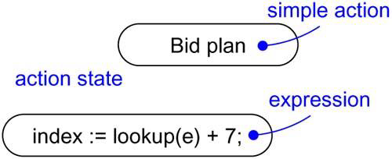
Action States

Slide 12
Activity States
In contrast, activity states can be further decomposed, their activity being represented by other activity diagrams.
Activity states are non-atomic and can be interrupted, considered to take some duration to complete.
There is no difference in the notation of activity states and action states except that the activity states may have additional information like entry and exit actions and submachine specifications as shown below:

Slide 13
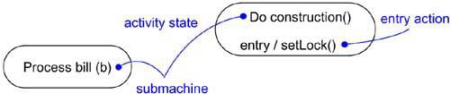
Activity States

Slide 14
Transitions
When the action or activity of a state completes, flow of control passes immediately to the next action or activity state.
This flow is represented as transitions to show the path from one action or activity state to the next action or activity state.
In UML, a transition is represented as a simple directed line, as shown in below figure.

Slide 15
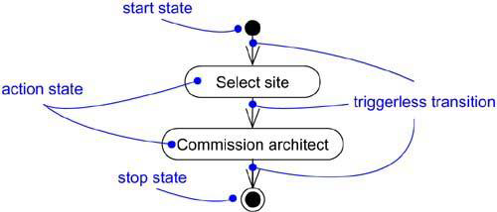
Transitions
A flow of control has to start and end someplace. Therefore, as shown in the below figure, we can specify the initial state (solid ball) and stop state (a solid ball inside a hollow circle).
Fig: Triggerless Transitions

Slide 16
Branching
Like in flowcharts, we can include a branch, which specifies alternate paths taken based on some Boolean expression which is also known as a guard condition.
In UML, a branch is represented as a diamond.
A branch may have one incoming transition and two or more outgoing transitions.
Across all these outgoing transitions, guards should not overlap, but they should cover all possibilities.

Slide 17
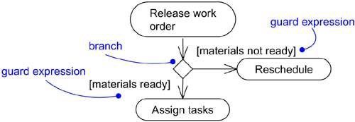
Branching
Figure : Branching

Slide 18
Forking and Joining
While modeling flow of control, it is common to encounter flows that are concurrent or parallel.
In UML, a synchronization bar is used to specify the forking and joining of these parallel flows of control.
A synchronization bar is represented as a thick vertical or horizontal line.

Slide 19
Forking and Joining
A fork may have one incoming transition and two or more outgoing transitions, each of which represents an independent flow of control.
Below the fork, the activities in each flow carry out in parallel.

Slide 20
Forking and Joining
A join represents the synchronization of two or more concurrent flows of control.
A join may have two or more incoming transitions and one outgoing transition.
At the join, all the concurrent flows synchronize, meaning that each flow waits for the other to join and continues on below the join.

Slide 21
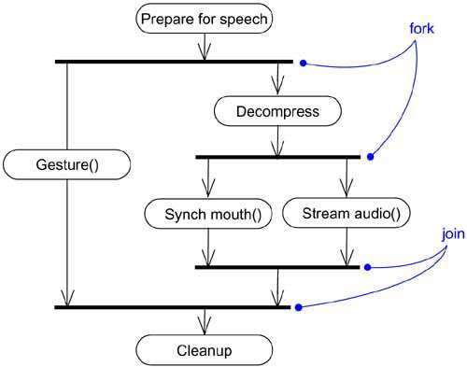
Forking and Joining

Slide 22
Swimlanes
In activity diagrams, the activity states can be divided into logical groups, each group representing the object responsible for the activities.
In UML, each group is known as a swimlane because, visually, each group is divided from its neighbor by a vertical solid line as shown in the below figure.

Slide 23
Swimlanes
Each swimlane has its own name.
In an activity diagram partitioned into swimlanes, every activity belongs to exactly one swimlane, but transitions may cross lanes.

Slide 24
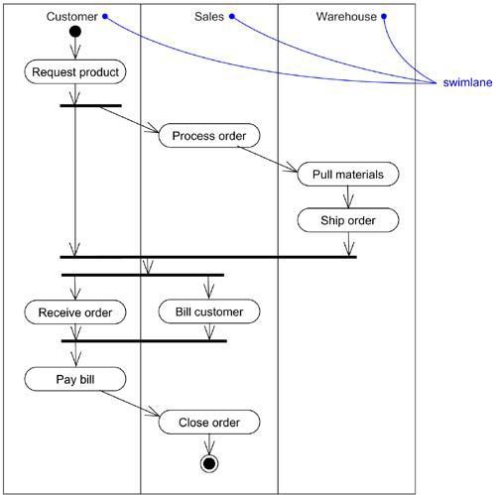
Swimlanes

Slide 25
Object Flow
Objects may be involved in the flow of control associated with an activity diagram.
As below figure shows, we can specify the things that are involved in an activity diagram by placing these objects in the diagram, connected using a dependency to the activity or transition that creates, destroys, or modifies them.
This use of dependency relationships and objects is called an object flow because it represents the participation of an object in a flow of control.

Slide 26
Object Flow
In addition to showing the flow of an object through an activity diagram, you can also show how its role, state and attribute values change.
As shown in the figure, you represent the state of an object by naming its state in brackets below the object's name.
Similarly, you can represent the value of an object's attributes by rendering them in a compartment below the object's name.

Slide 27
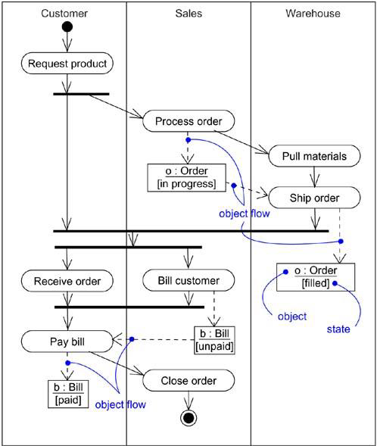
Object Flow

Slide 28
Common Uses
We use activity diagrams to model the dynamic aspects of a system.
These dynamic aspects may involve the activity of any kind of abstraction in any view of a system's architecture, including classes, interfaces, components, and nodes.
When modeling the dynamic aspects of a system, you’ll use activity diagrams in two ways:
To model a workflow
To model an operation

Slide 29
Common Modeling Techniques
There are Three modeling technique for Activity Diagrams
Modeling a workflow
Modeling a operation
Forward and Reverse Engineering

Slide 30
Modeling a workflow
To model a workflow:
Establish a focus for the workflow.
Select the objects that have the high-level responsibilities for parts of the overall workflow. Create a swimlane for each of these objects.
Identify the pre-conditions of the workflow’s initial state and the post-conditions of the workflow’s final state.
Starting at the workflow’s initial state layout the actions and activities that take place and render them as actions states or activity states.

Slide 31
Modeling a workflow
For complex actions, or for sets of actions that appear multiple times, collapse them into activity states and provide a separate activity diagram for them.
Connect the action and activity states by transitions. Consider branching and then consider forking and joining.
If there are important objects that are involved in the workflow, render them in the activity diagram as well.

Slide 32
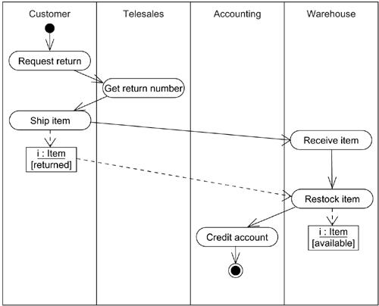
Modeling a workflow

Slide 33
Modeling a operation
To model an operation:
Collect the abstractions involved in an operation like: parameters, attributes of the enclosing class and the neighboring class.
Identify the operation’s pre-conditions and the operation’s post-conditions.
Beginning at the operation’s initial state, define the actions and activities and render them as action states and activity states respectively.

Slide 34
Modeling a operation
Use branching as necessary to specify conditional paths and iteration.
If this operation is owned by an active class, use forking and joining as necessary to specify parallel flows of control.

Slide 35
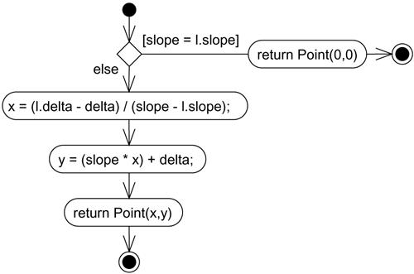
Modeling a operation

Slide 36
Forward and Reverse Engineering
Forward engineering (the creation of code from a model) is possible for activity diagrams, if the context of the diagram is an operation.
Reverse engineering (the creation of a model from code) is also possible for activity diagrams, if the context of the code is the body of an operation.

