Slide 1
Time and Space

Slide 2
Topics to be covered
Getting Started
Terms and Concepts
Common Modeling Techniques

Slide 3
Introduction
Modeling time and space is an essential element of any real time and/or distributed system.
We use a number of the UML's features, including timing marks, time expressions, constraints, and tagged values, to visualize, specify, construct, and document these systems.

Slide 4
Getting Started
A distributed system is one in which components may be physically distributed across nodes.
These nodes may represent different processors physically located in the same box, or they may even represent computers that are located half a world away from one another.

Slide 5
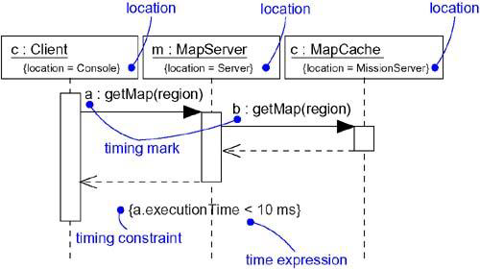
Getting Started
To represent the modeling needs of real time and distributed systems, the UML provides a graphic representation for timing marks, time expressions, timing constraints, and location, as shown in below figure.

Slide 6
Terms and Concepts
A timing mark is a denotation for the time at which an event occurs.
Graphically, a timing mark is formed as an expression from the name given to the message.
A time expression is an expression that evaluates to an absolute or relative value of time.

Slide 7
Terms and Concepts
A timing constraint is a semantic statement about the relative or absolute value of time.
Graphically, timing constraint is rendered as for any constraint – i.e, a string enclosed by brackets and generally connected to an element by a dependency relationship.
Location is the placement of a component on a node.
Graphically, location is rendered as a tagged value – i.e, a string enclosed by brackets and placed below an element's name, or as the nesting of components inside nodes.

Slide 8
Time
Real time systems are time-critical systems.
Events may happen at regular or irregular times; the response to an event must happen at predictable absolute times or at predictable times relative to the event itself.
The passing of messages represents the dynamic aspect of any system.
Messages in an interaction are usually not given names, they are mainly rendered with the name of an event, such as a signal or a call.

Slide 9
Time
Given a message name, we can refer to any of three functions of that message i.e, sendTime, receiveTime, and transmissionTime.
For synchronous calls, we can also reference the round-trip message time with executionTime.
As shown in below figure, we can place these time expressions in a timing constraint to specify the timing behavior of the system.
As constraints, you can render them by placing them adjacent to the appropriate message, or you can explicitly attach them using dependency relationships.

Slide 10
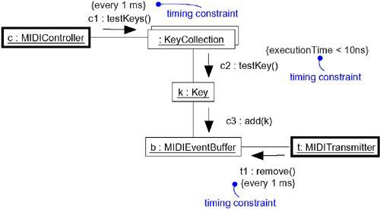
Time

Slide 11
Location
Distributed systems, encompass components that are physically scattered among the nodes of a system.
For many systems, components are fixed in place at the time they are loaded on the system; in other systems, components may migrate from node to node.

Slide 12
Location
In the UML, you model the deployment view of a system by using deployment diagrams that represent the topology of the processors and devices on which your system executes.
Artifacts such as executables, libraries, and tables reside on these nodes.
Each instance of a node will own instances of certain components, and each instance of a component will be owned by exactly one instance of a node.

Slide 13
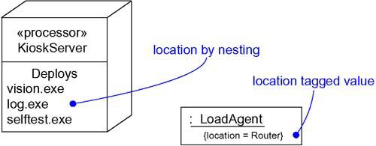
Location
As below figure shows, the executable component vision.exe may reside on the node named KioskServer.

Slide 14
Common Modeling Techniques
There are three Modeling Techniques are there in Time and space
Modeling Timing Constraints
Modeling the Distribution of Objects
Modeling Objects that Migrate

Slide 15
Modeling Timing Constraints
To model timing constraints,
For each event in an interaction, consider whether it must start at some absolute time. Model that real time property as a timing constraint on the message.
For each interesting sequence of messages in an interaction, consider whether there is an associated maximum relative time for that sequence. Model that real time property as a timing constraint on the sequence.
For each time critical operation in each class, consider its time complexity. Model those semantics as timing constraints on the operation.

Slide 16
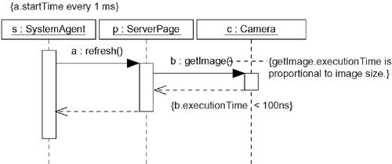
Modeling Timing Constraints

Slide 17
Modeling the Distribution of Objects
To model the distribution of objects,
For each interesting class of objects in your system, consider its locality of reference.
Next consider patterns of interaction among related sets of objects. Co-locate sets of objects that have high degrees of interaction, to reduce the cost of communication. Partition sets of objects that have low degrees of interaction.
Next consider the distribution of responsibilities across the system. Redistribute your objects to balance the load of each node.
Consider also issues of security, volatility, and quality of service, and redistribute your objects as appropriate.
Render this allocation in one of two ways:
  By nesting objects in the nodes of a deployment diagram.
  By explicitly indicating the location of the object as a tagged value.

Slide 18
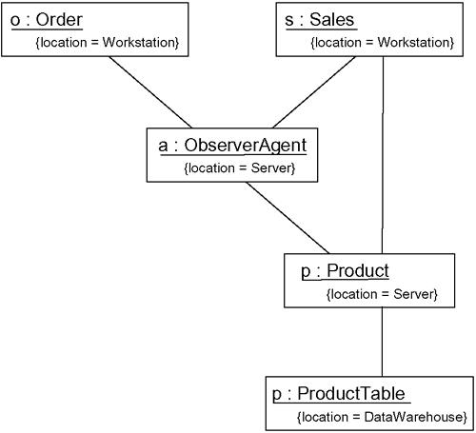
Modeling the Distribution of Objects

Slide 19
Modeling Objects that Migrate
To model the migration of objects,
Select an underlying mechanism for physically transporting objects across nodes.
Render the allocation of an object to a node by explicitly indicating its location as a tagged value.
Using the become and copy stereotyped messages, render the allocation of an object to a new node.
Consider the issues of synchronization and identity.

Slide 20
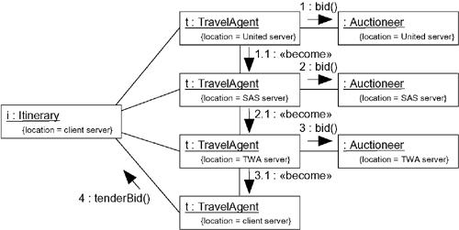
Modeling Objects that Migrate

