Slide 1
Architectural Modeling
Unit VI

Slide 2
Syllabus
Components
Deployment
Component diagrams
Deployment diagrams

Slide 3
Components

Slide 4
Topics to be covered
Getting Started
Terms and Concepts
Common Modeling Techniques

Slide 5
Introduction
A component is a physical and replaceable part of a system that conforms to and provides the realization of a set of interfaces.
We use components to model the physical things that may reside on a node, such as executables, libraries, tables, files, and documents.
A component typically represents the physical packaging of otherwise logical elements, such as classes, interfaces, and collaborations.

Slide 6
Getting Started
While building a software-intensive system, we do logical modeling to visualize, specify, and document your decisions about the vocabulary of your domain and the structural and behavioral way those things collaborate.
We do physical modeling to construct the executable system.
Whereas these logical things live in the conceptual world, the physical things live in the world of bits.

Slide 7
Getting Started
In the UML, all these physical things are modeled as components.
A component is a physical thing that conforms to and realizes a set of interfaces.
Interfaces bridge your logical and physical models.
In software, many operating systems and programming languages directly support the concept of a component.

Slide 8
Getting Started
Object libraries, executables, COM+ components, and Enterprise Java Beans are all examples of components that may be represented directly in the UML by using components.
Not only can components be used to model these kinds of things, they can also be used to represent other things that participate in an executing system, such as tables, files, and documents.

Slide 9
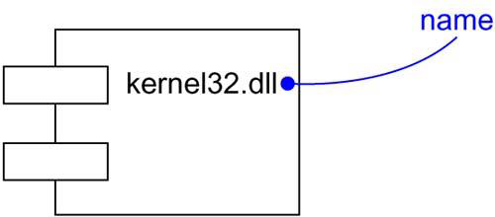
Getting Started
The UML provides a graphical representation of a component, as shown in below figure.
This canonical notation permits you to visualize a component apart from any operating system or programming language.

Slide 10
Terms and Concepts
A component is a physical and replaceable part of a system that conforms to and provides the realization of a set of interfaces.
Graphically, a component is rendered as a rectangle with tabs.

Slide 11
Names
Every component must have a name that distinguishes it from other components.
A name is a textual string.
That name alone is known as a simple name; a path name is the component name prefixed by the name of the package in which that component lives.
A component is typically drawn showing only its name, as shown in below figure.

Slide 12
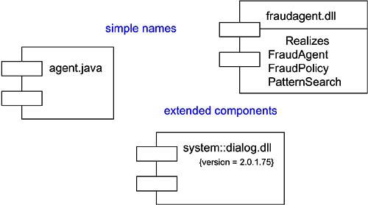
Names
Just as with classes, you may draw components adorned with tagged values or with additional compartments to expose their details.

Slide 13
Components and Classes
In many ways, components are like classes.
Both have names, both may realize a set of interfaces, both may participate in dependency, generalization and association relationships, both may be nested, and both may have instances.
However, there are some significant differences between components and classes:

Slide 14
Components and Classes
Classes represent logical abstractions, components represent physical things that live in the world of bits. In short, components may live on nodes, classes may not.
Components represent the physical packaging of otherwise logical components and are at a different level of abstraction.
Classes may have attributes and operations directly. In general, components only have operations that are reachable only through their interfaces.

Slide 15
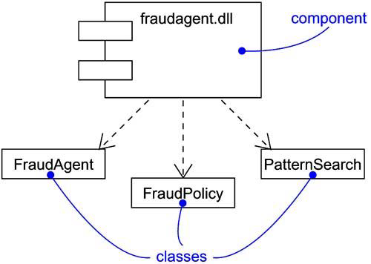
Components and Classes
The relationship between a component and the classes it implements can be shown explicitly by using a dependency relationship as shown below:

Slide 16
Components and Interfaces
An interface is a collection of operations that are used to specify a service of a class or a component.
We can show the relationship between a component and its interfaces in one of the two ways.

Slide 17
Components and Interfaces
The first style renders the interfaces in its elided, iconic form. The component that realizes the interfaces is connected to the interface using an elided realization relationship.
The second style renders the interface in its expanded form, perhaps revealing its operations. The component that realizes the interface is connected to the interface using a full realization relationship.

Slide 18
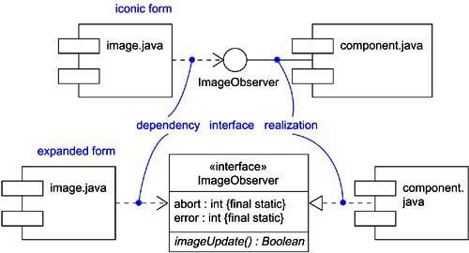
Components and Interfaces
In both cases, the component that accesses the services of the other component through the interfaces is connected to the interface using a dependency relationship.

Slide 19
Binary Replaceability
The basic intent of every component-based operating system facility is to permit the assembly of systems from binary replaceable parts.
This means that we can create a system out of components and then evolve the system by adding new components and replacing the old ones, without rebuilding the system.

Slide 20
Binary Replaceability
A component is a physical and replaceable part of a system that conforms to and provides the realization of a set of interfaces.
First, a component is physical.
It lives in the world of bits, not concepts.
Second, a component is replaceable.
A component is substitutable means it is possible to replace a component with another that conforms to the sane interfaces.

Slide 21
Binary Replaceability
Third, a component is part of a system.
A component rarely stands alone. Rather, a given component collaborates with other components and in so doing exists in the architectural or technology context in which it is intended to be used.
Fourth, a component conforms to and provides the realization of a set of interfaces.

Slide 22
Kinds of Components
Three kinds of components may be distinguished.
First, there are deployment components. These are the components necessary and sufficient to form an executable system, such as dynamic libraries (DLLs) and executables (EXEs).

Slide 23
Kinds of Components
Second, there are work product components. These components are generally the residue of the development process, consisting of things such as the source code files and data files from which deployment components are created.
Third are execution components. These components are created as a consequence of an executing system, such as COM+ object, which is instantiated from a DLL.

Slide 24
Organizing Components
We can organize components by grouping them in packages in the same manner in which you organize classes.
We can also organize components by specifying dependency, generalization, association (including aggregation), and realization relationships among them.

Slide 25
Standard Elements
All the UML’s extensibility mechanisms apply to components.
Most often, we’ll use tagged values to extend the component properties and stereotypes to specify new kind of components.
The UML defines five standard stereotypes that apply to components:

Slide 26
Standard Elements
S.No | Stereotypes | Specification
1 | executable | Specifies a component that may be executed on a node
2 | library | Specifies a static or dynamic object library
3 | table | Specifies a component that represents a database table
4 | file | Specifies a component that represents a document containing source code or data
5 | document | Specifies a component that represents a document

Slide 27
Common Modeling Techniques
There are four modeling techniques are there in Components:
Modeling Executables and Libraries
Modeling Tables, Files, and Documents
Modeling an API
Modeling Source Code

Slide 28
Modeling Executables and Libraries
To model executables and libraries:
Identify the partitioning of the physical system. Consider the impact of the technical, configuration management and reuse issues.
Model any executables and libraries as components, using the appropriate standard elements.
Model the significant interfaces that some components use and others realize.
As necessary to communicate your intent, model the relationships among these executables, libraries and interfaces.

Slide 29
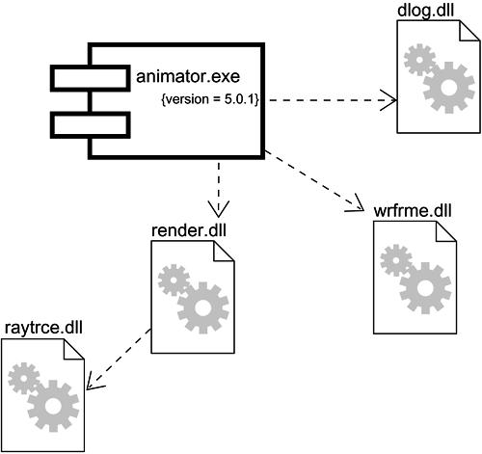
Modeling Executables and Libraries

Slide 30
Modeling Tables, Files, and Documents
To model tables, files and documents:
Identify the components that are part of the physical implementation of your system.
Model these things as components.
As necessary to communicate your intent, model the relationships among these components and other executables, libraries and interfaces in the system.

Slide 31
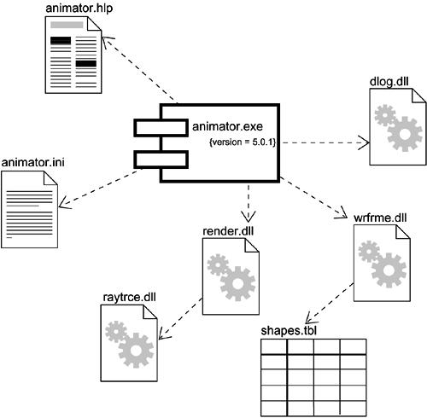
Modeling Tables, Files, and Documents

Slide 32
Modeling an API
To model an API:
Identify the programmatic seems in the system and model each seem as an interface.
Expose only those properties of the interface that are important to visualize the given context. Otherwise, hide these properties, keeping them in the interface’s specification for reference, as necessary.
Model the realization of each API only as it is important to show the configuration of a specific implementation.

Slide 33
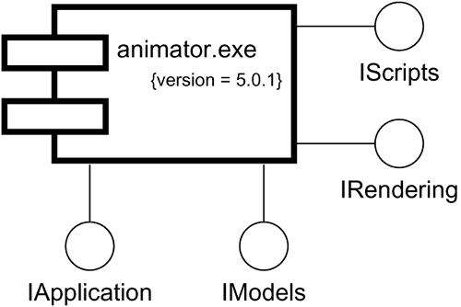
Modeling an API

Slide 34
Modeling Source Code
To model source code:
Depending on the constraints imposed by your development tools, model the files used to store the details of all your logical elements, along with their compilation dependencies.
Use tagged values if you want to use configuration management and version control tools.
As far as possible, let your development tools manage the relationships among these files, and use the UML only to visualize and document these relationships.

Slide 35
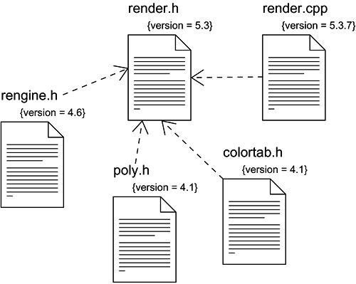
Modeling Source Code

