Slide 1
Component Diagrams

Slide 2
Topics to be covered
Getting Started
Terms and Concepts
Common Modeling Techniques

Slide 3
Introduction
Component diagrams are one of the two kinds of diagrams for modeling the physical aspects of object-oriented software systems.
A component diagram shows the organization and dependencies among a set of components.
We use component diagrams to model the static implementation view of a software system.

Slide 4
Introduction
Component diagrams are essentially class diagrams that focus on a system‘s components.
Component diagrams are not only important for visualizing, specifying, and documenting component-based systems, but also for constructing executable systems through forward and reverse engineering.

Slide 5
Getting Started
With the UML, you use component diagrams to visualize the static aspect of these physical components and their relationships and to specify their details for construction, as shown in below figure.

Slide 6
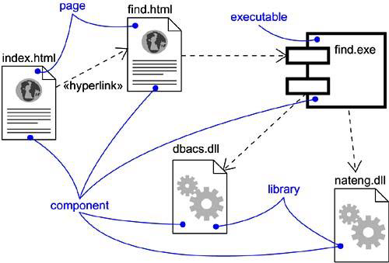
Getting Started

Slide 7
Terms and Concepts
A component diagram shows a set of components and their relationships.
Graphically, a component diagram is a collection of vertices and arcs.

Slide 8
Common Properties
A component diagram is just a special kind of diagram and shares the same common properties as do all other diagrams - a name and graphical contents that are a projection into a model.
What distinguishes a component diagram from all other kinds of diagrams is its particular content.

Slide 9
Contents
Component diagrams commonly contain
Components
Interfaces
Dependency, generalization, association, and realization relationships
Like all other diagrams, component diagrams may contain notes and constraints.
Component diagrams may also contain packages or subsystems.

Slide 10
Common Uses
When modeling the static implementation view of a system, we will typically use component diagrams in one of four ways:
To model source code
To model executable releases
To model physical databases
To model adaptable systems

Slide 11
Common Modeling Techniques
There are five modeling techniques are there in Component Diagrams
Modeling Source Code
Modeling an Executable Release
Modeling a Physical Database
Modeling Adaptable Systems
Forward and Reverse Engineering

Slide 12
Modeling Source Code
To model a system’s source code:
Either by forward or reverse engineering, identify the set of source code files of interest and model them as components stereotypes as files.
For larger systems, use packages to show groups of source code files.
Consider using tagged values indicating such information as the version number of the source code file, its author, and the date it was last changed.
Model the compilation dependencies among these files using dependencies.

Slide 13
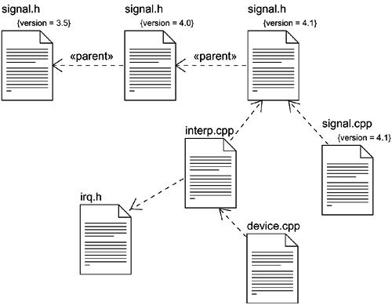
Modeling Source Code

Slide 14
Modeling an Executable Release
To model an executable release:
Identify the set of components you’d like to model.
Consider the stereotype of each component in this set.
For each component in this set, consider its relationship to its neighbors. Most, often this will involve interfaces that are realized by certain components and then imported by others.

Slide 15
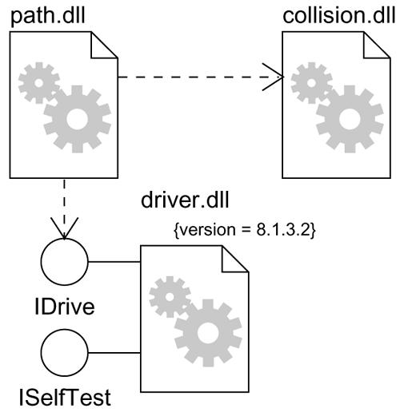
Modeling an Executable Release

Slide 16
Modeling a Physical Database
To model a physical database:
Identify the classes in your model that represent your logical database schema.
Select a strategy for mapping these classes to tables. You have to also consider the physical distribution of your databases.
To visualize, specify, construct and document your mapping, create a component diagram that contains components stereotyped as tables.
Where possible, use tools to help you transform your logical design into a physical design.

Slide 17
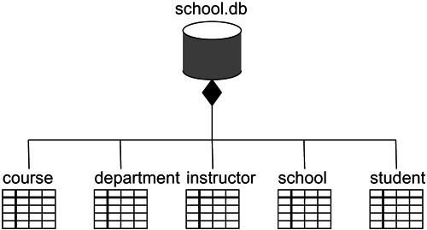
Modeling a Physical Database

Slide 18
Modeling Adaptable Systems
To model an adaptable system:
Consider the physical distribution of the components that may migrate from node to node. We can specify the location of a component instance by marking it with a location tagged value.
If you want to model the actions that cause a component to migrate, create a corresponding interaction diagram that contains component instances. We can illustrate a change of location by drawing the same instance more than once, but with different values for its location tagged value.

Slide 19
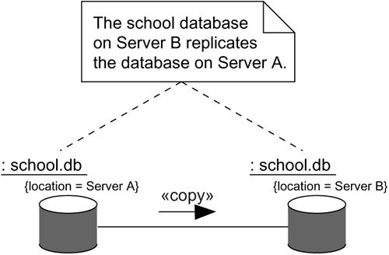
Modeling Adaptable Systems

Slide 20
Forward and Reverse Engineering
To forward engineer a component diagram,
For each component, identify the classes or collaborations that the component implements.
Choose the target for each component. Your choice is basically between source code or a binary library or executable.
Use tools to forward engineer your models.

Slide 21
Forward and Reverse Engineering
To reverse engineer a component diagram,
Choose the target you want to reverse engineer. Source code can be reverse engineered to components and then classes. Binary libraries can be reverse engineered to uncover their interfaces. Executables can be reverse engineered the least.
Using a tool, point to the code you'd like to reverse engineer. Use your tool to generate a new model or to modify an existing one that was previously forward engineered.
Using your tool, create a component diagram by querying the model.

Slide 22
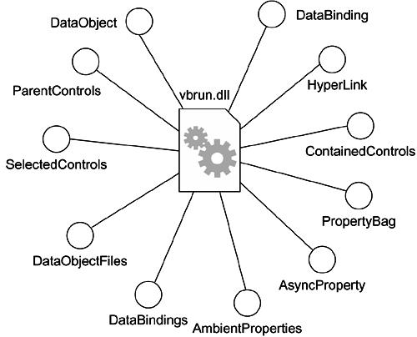
Forward and Reverse Engineering

