Slide 1
Use Cases

Slide 2
Topics to be Covered
Getting Started
Terms and Concepts
Common Modeling Techniques

Slide 3
Getting Started
A use case specifies the behavior of a system or a part of a system and is a description of a set of sequences of actions, including variants, that a system performs to yield an observable result of value to an actor.

Slide 4
Getting Started
A use case involves the interaction of actors and the system.
An actor represents a coherent set of roles that users of use cases play when interacting with these use cases.
Actors can be human or they can be automated systems.

Slide 5
Getting Started
You can apply use cases to your whole system. You can also apply use cases to part of your system, including subsystems and even individual classes and interfaces.
In each case, these use cases not only represent the desired behavior of these elements, but they can also be used as the basis of test cases for these elements as they evolve during development.
Use cases applied to subsystems are excellent sources of regression tests; use cases applied to the whole system are excellent sources of integration and system tests.
The UML provides a graphical representation of a use case and an actor.

Slide 6
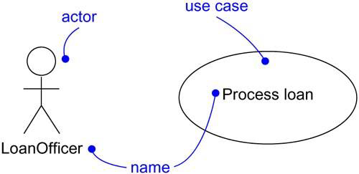
Getting Started

Slide 7
Terms and Concepts
A use case is a description of a set of sequences of actions, including variants, that a system performs to yield an observable result of value to an actor.
Graphically, a use case is rendered as an ellipse.

Slide 8
Names
Every use case must have a name that distinguishes it from other use cases. A name is a textual string.
That name alone is known as a simple name; a path name is the use case name prefixed by the name of the package in which that use case lives.

Slide 9
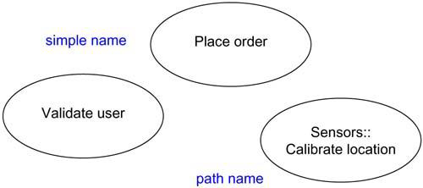
Names
A use case is typically drawn showing only its name, as shown in below figure.
Figure: Simple and Path Names

Slide 10
Use Cases and Actors
An actor represents a coherent set of roles that users of use cases play when interacting with these use cases.
An actor represents a role that a human, a hardware device, or even another system plays with a system.

Slide 11
Use Cases and Actors
An instance of an actor represents an individual interacting with the system in a specific way.
You'll use actors in your models, actors are not actually part of the system. They live outside the system.

Slide 12
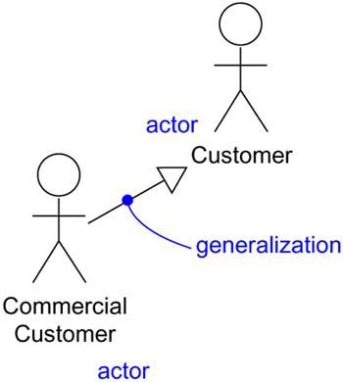
Use Cases and Actors
As Figure indicates, actors are rendered as stick figures. You can define general kinds of actors and specialize them using generalization relationships.
Actors may be connected to use cases only by association. An association between an actor and a use case indicates that the actor and the use case communicate with one another, each one possibly sending and receiving messages.

Slide 13
Use Cases and Flow of Events
A use case describes what a system does but it does not specify how it does that.
When you model, it's important that you keep clear the separation of concerns between this outside and inside view.
We can specify the behavior of a use case by describing the flow of events in text clearly enough for an outsider to understand it easily.

Slide 14
Use Cases and Flow of Events
When we write the flow of events, we must specify when the use case starts and ends, what objects are exchanged between the system and the actor, the basic/main flow and alternate flows of events.
For example in an ATM system, we can describe the use case “Validate User” in the following way:

Slide 15
Main flow of events
The use case starts when the system prompts the customer for a PIN number.
The customer can now enter a PIN number via the keypad.
The customer commits the entry by pressing the Enter button.
The system then checks this PIN number to see if its valid or not.
If the PIN is valid, the system acknowledges the entry, thus ending the use case.

Slide 16
Exceptional flow of events
Customer can cancel the transaction at any point by pressing the Cancel button thereby restarting the use case.
No changes are made to the customer’s state.

Slide 17
Exceptional flow of events
Customer can clear the PIN number anytime before confirming it and reenter a new PIN number again.

Slide 18
Exceptional flow of events
If the Customer enters an invalid PIN number, the use case restarts.
If this happens, three times in a row, the system cancels the transaction, preventing the Customer from interacting with the ATM for 60 seconds.

Slide 19
Use Cases and Scenarios
A scenario is a specific sequence of actions that illustrates behavior.
Scenarios are to use cases as instances are to classes, meaning that a scenario is basically one instance of a use case.
For example, in an online shopping system consider the use case “Purchase Product”.
For this use case, a scenario can be:
  user Ramesh purchases a laptop.
  Another scenario can be user Mahesh purchases a washing machine etc..

Slide 20
Use Cases and Collaborations
A use case specifies what the system does but does not specify how it is implemented.
A use case is implemented by creating a collection of classes and other elements that work together to achieve the behavior of the use case.
This collection of elements, including both its static and dynamic structure, is modeled in UML as collaboration.

Slide 21
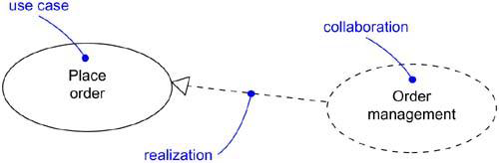
Use Cases and Collaborations

Slide 22
Organizing Use Cases
We can organize the use cases by grouping them in packages in the same manner in which we can organize classes.
We can also organize use cases by specifying generalization, include and extend relationships.
We apply these relationships in order to factor common behavior and in order to factor variants (alternatives).

Slide 23
Organizing Use Cases
Generalization among use cases is just like generalization among classes. Here it means that the child use case inherits the behavior and meaning of the parent use case.
For example, in a banking system, you might have the use case Validate User, which is responsible for verifying the identify of the user.
You might then have two specialized children of this use case (Check password and Retinal scan), both of which behave just like Validate User and may be applied anywhere Validate User appears.

Slide 24
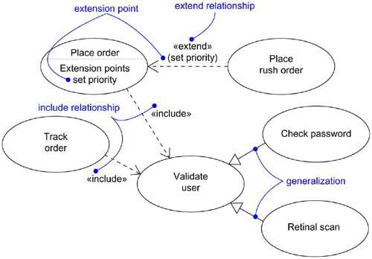
Organizing Use Cases

Slide 25
Organizing Use Cases
An include relationship between use cases means that the base use case explicitly incorporates the behavior of the included use case.
Such relationship is represented as a dependency stereotyped with include.
In an include relationship, the included use case cannot exist without the base use case.
The include relationship is used to separate the common behavior.

Slide 26
Organizing Use Cases
An extend relationship between use cases means that the extending use case extends the behavior of the base use case.
Such relationship is graphically represented as dependency stereotyped with exclude.
In a extend relationship, the base use case may exist on its own but at certain points its behavior may be extended by the behavior of another use case.
The extend relationship is used to separate the optional behavior.

Slide 27


Organizing Use Cases

Slide 28
Common Modeling Techniques
There is only one type modeling techniques for Use Cases.
Modeling the Behavior of an Element

Slide 29
Common Modeling Techniques
To model the behavior of an element:
Identify the actors that interact with the element.
Organize the actors by identifying the general and more specialized roles.
For each actor, consider the primary ways in which the actor interacts with the element.

Slide 30
Common Modeling Techniques
Consider also the alternative ways in which the actor interacts with the element.
Organize these behaviors as use cases, applying include and extend relationships to factor common behavior and distinguish exceptional behavior.

Slide 31
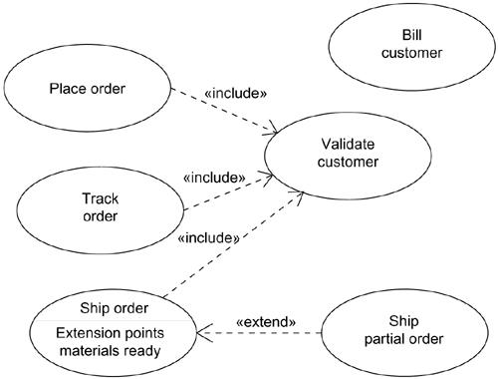
Common Modeling Techniques
Figure: Modeling the Behavior of an Element

