Slide 1
Statechart Diagrams

Slide 2
Topics to be covered
Getting Started
Terms and Concepts
Common Modeling Techniques

Slide 3
Introduction
Statechart diagrams are one of the five diagrams in the UML for modeling the dynamic aspects of systems.
A statechart diagram shows a state machine.
An activity diagram is a special case of a statechart diagram in which all or most of the states are activity states and all or most of the transitions are triggered by completion of activities in the source state.
Both activity and statechart diagrams are useful in modeling the lifetime of an object.
An activity diagram shows flow of control from activity to activity, a statechart diagram shows flow of control from state to state.

Slide 4
Introduction
We use statechart diagrams to model the dynamic aspects of a system.
Statechart diagrams may be attached to classes, use cases, or entire systems in order to visualize, specify, construct, and document the dynamics of an individual object.
Statechart diagrams are not only important for modeling the dynamic aspects of a system, but also for constructing executable systems through forward and reverse engineering.

Slide 5
Getting Started
In the UML, you model the event-ordered behavior of an object by using statechart diagrams.
As below figure, a statechart diagram is simply a presentation of a state machine, emphasizing the flow of control from state to state.

Slide 6
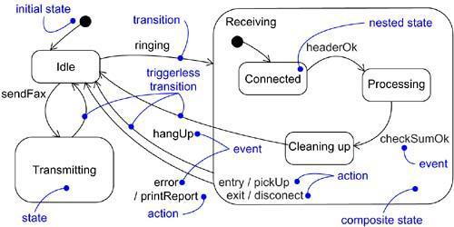
Getting Started
Figure: Statechart Diagram

Slide 7
Terms and Concepts
A statechart diagram shows a state machine, emphasizing the flow of control from state to state.
A state machine is a behavior that specifies the sequences of states an object goes through during its lifetime in response to events, together with its responses to those events.
A state is a condition or situation in the life of an object during which it satisfies some condition, performs some activity, or waits for some event.
An event is the specification of a significant occurrence that has a location in time and space.

Slide 8
Terms and Concepts
In the context of state machines, an event is an occurrence of a stimulus that can trigger a state transition.
A transition is a relationship between two states indicating that an object in the first state will perform certain actions and enter the second state when a specified event occurs and specified conditions are satisfied.
An activity is ongoing nonatomic execution within a state machine.
An action is an executable atomic computation that results in a change in state of the model or the return of a value.
Graphically, a statechart diagram is a collection of vertices and arcs.

Slide 9
Common Properties
A statechart diagram is just a special kind of diagram and shares the same common properties as do all other diagrams i.e, a name and graphical contents that are a projection into a model.
What distinguishes a statechart diagram from all other kinds of diagrams is its content.

Slide 10
Contents
Statechart diagrams commonly contain
Simple states and composite states
Transitions, including events and actions
Like all other diagrams, statechart diagrams may contain notes and constraints.

Slide 11
Common Uses
When we model the dynamic aspects of a system, a class or a use case, we will use statechart diagrams in one way:
To model reactive (event-driven) objects

Slide 12
Common Modeling Technique
There are two Modeling Techniques are there in Statechart Diagrams
Modeling Reactive Objects
Forward and Reverse Engineering

Slide 13
Modeling Reactive Objects
To model a reactive object:
Choose the context for the state machine, whether it is a class, a use case or the system as a whole.
Choose the initial and final states for the object.
Decide on the stable states of the object. Start with the high-level states of the object and only then consider its possible substates.
Decide on the meaningful partial ordering of stable states over the lifetime of the object.
Decide on the events that may trigger a transition from state to state.

Slide 14
Modeling Reactive Objects
Attach actions to these transitions and/or to these states.
Consider ways to simplify your machine by using substates, branches, forks, joins and history states.
Check that all states are reachable under some combination of events.
Check that no state is a dead end.
Trace through the state machine, either manually or by using tools, to check it against expected sequences of events and their responses.

Slide 15
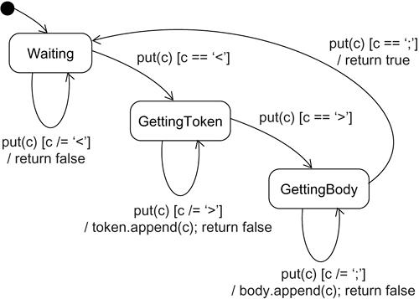
Modeling Reactive Objects

Slide 16
Forward and Reverse Engineering
Forward engineering (the creation of code from a model) is possible for statechart diagrams, especially if the context of the diagram is a class.
Reverse engineering (the creation of a model from code) is theoretically possible, but practically not very useful.

